Slide 1



PHARMACY MANAGEMENT SYSTEM AND PORTAL
By Hritaban Ghosh 19CS30053

Slide 2

PROJECT OVERVIEW
DESIGN CHOICES
FEATURES
PUBLIC VIEW
CUSTOMER VIEW
STAFF VIEW
VENDOR VIEW
ADMIN VIEW
AGENDA
FUTURE SCOPE

Slide 3
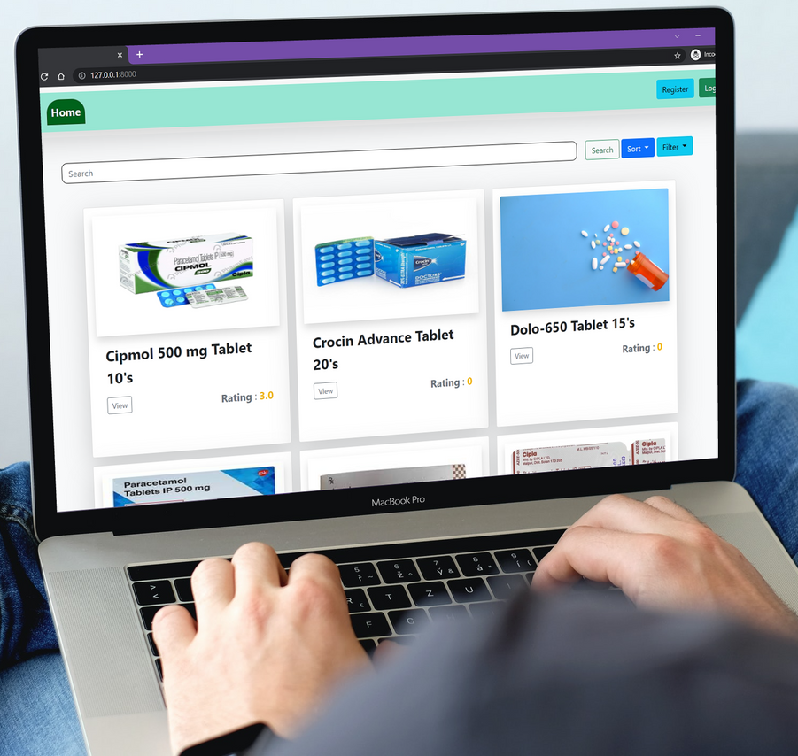

PHARMACY MANAGEMENT SYSTEM AND PORTAL
The pharmacy management system and portal is built to efficiently manage the inventory of the pharmacy as well as providing the customers with a online portal using which they can easily view the pharmacy at a glance without physically visiting it.

Slide 4




DESIGN CHOICES
Back-end Database: MySQL
Web Framework: Django
Front-End: HTML, CSS, and Javascript
Go Back to Agenda Page

Slide 5
WHY MYSQL?
Open-source and compatible
Fast and reliable
Availability
Scalability
Security

Slide 6
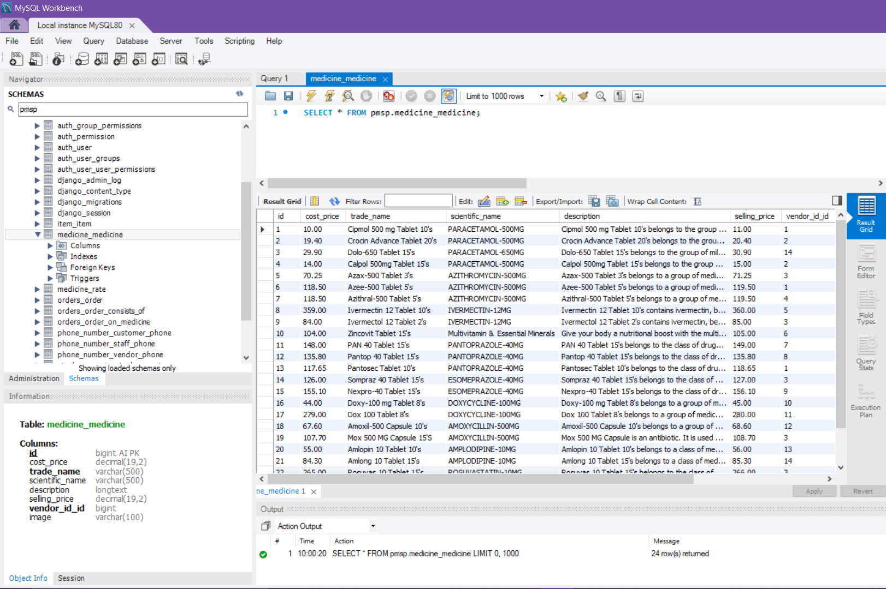

Slide 7
WHY DJANGO?
Simple syntax
MVC (Model-View-Controller) core architecture
Middleware support
Cross Platform
Flexibility

Slide 8
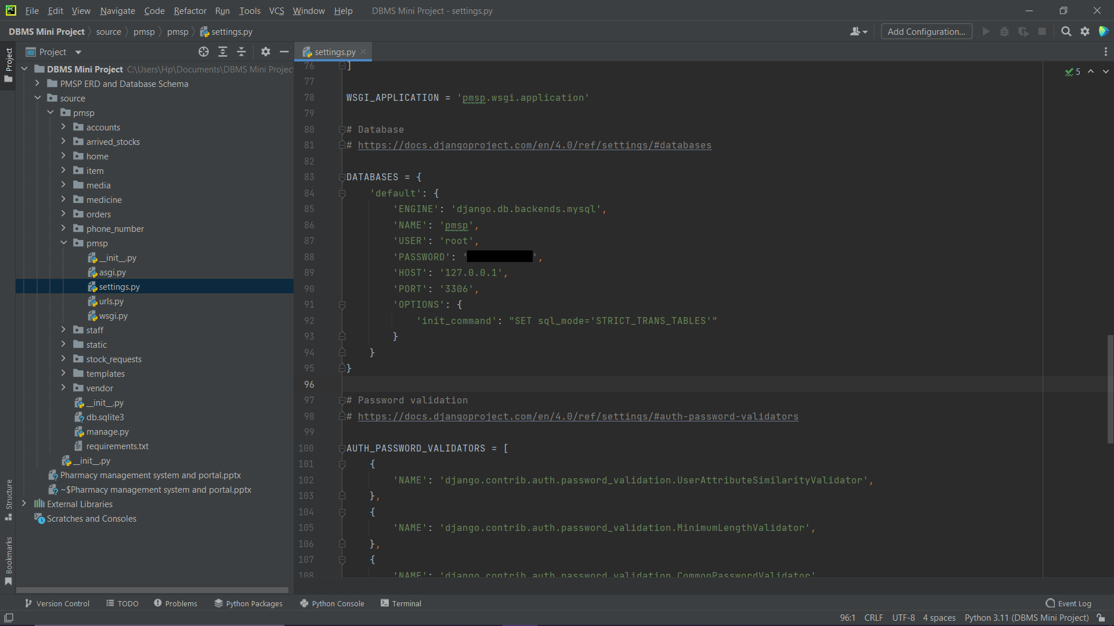

Slide 9


FEATURES
In the following slides all the features of PMSP will be discussed in detail

Slide 10
PUBLIC VIEW
In the following slides all the features accessible to the general public are explained in detail.

Slide 11
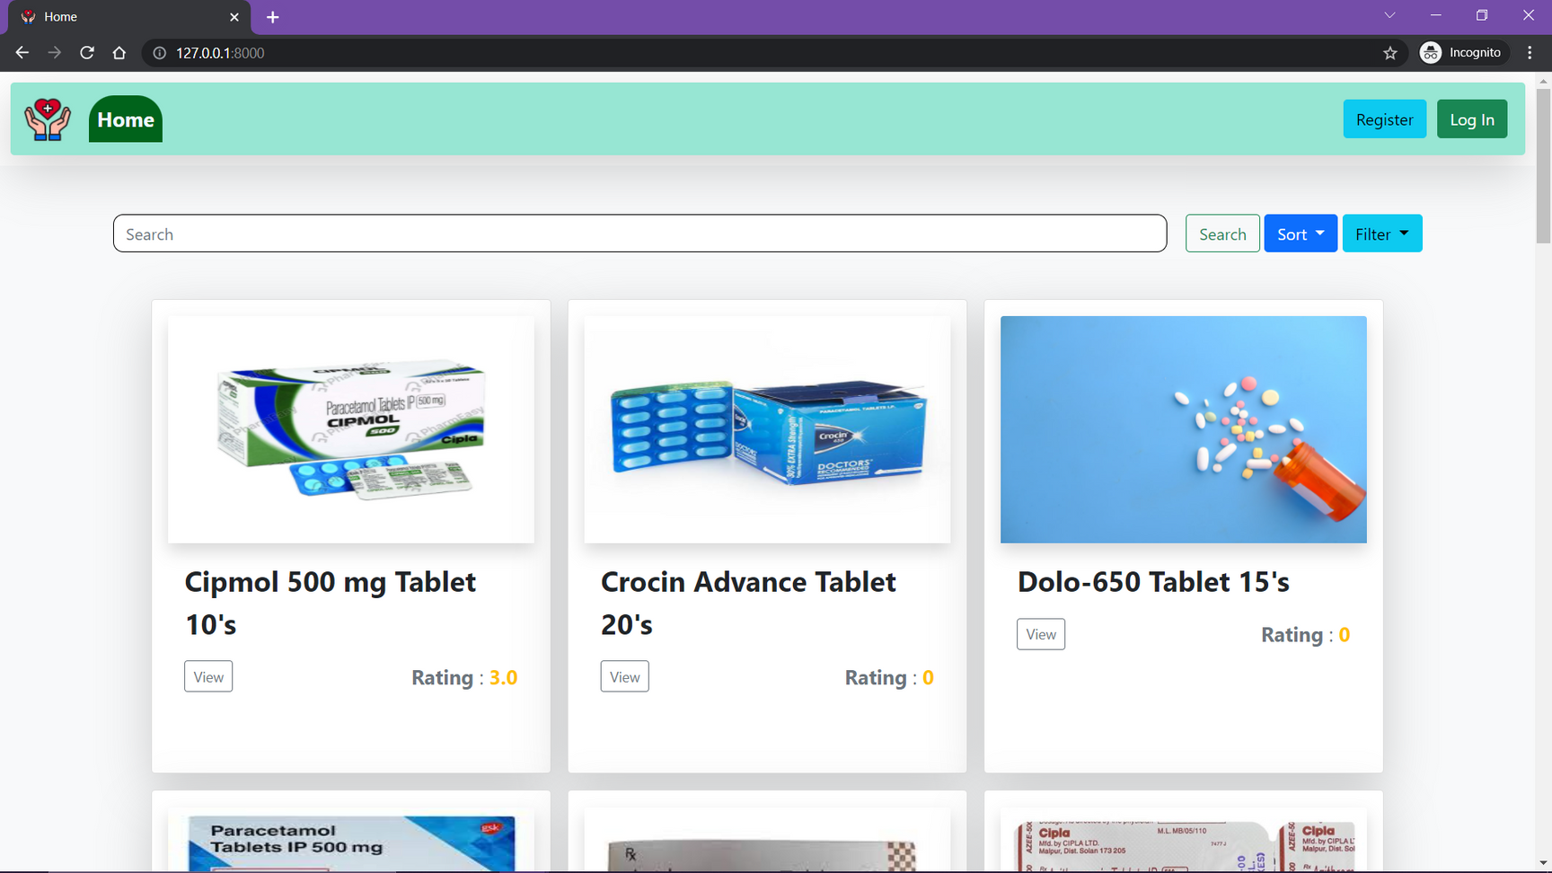
FEATURE 1 : VIEWING ALL MEDICINES

Slide 12
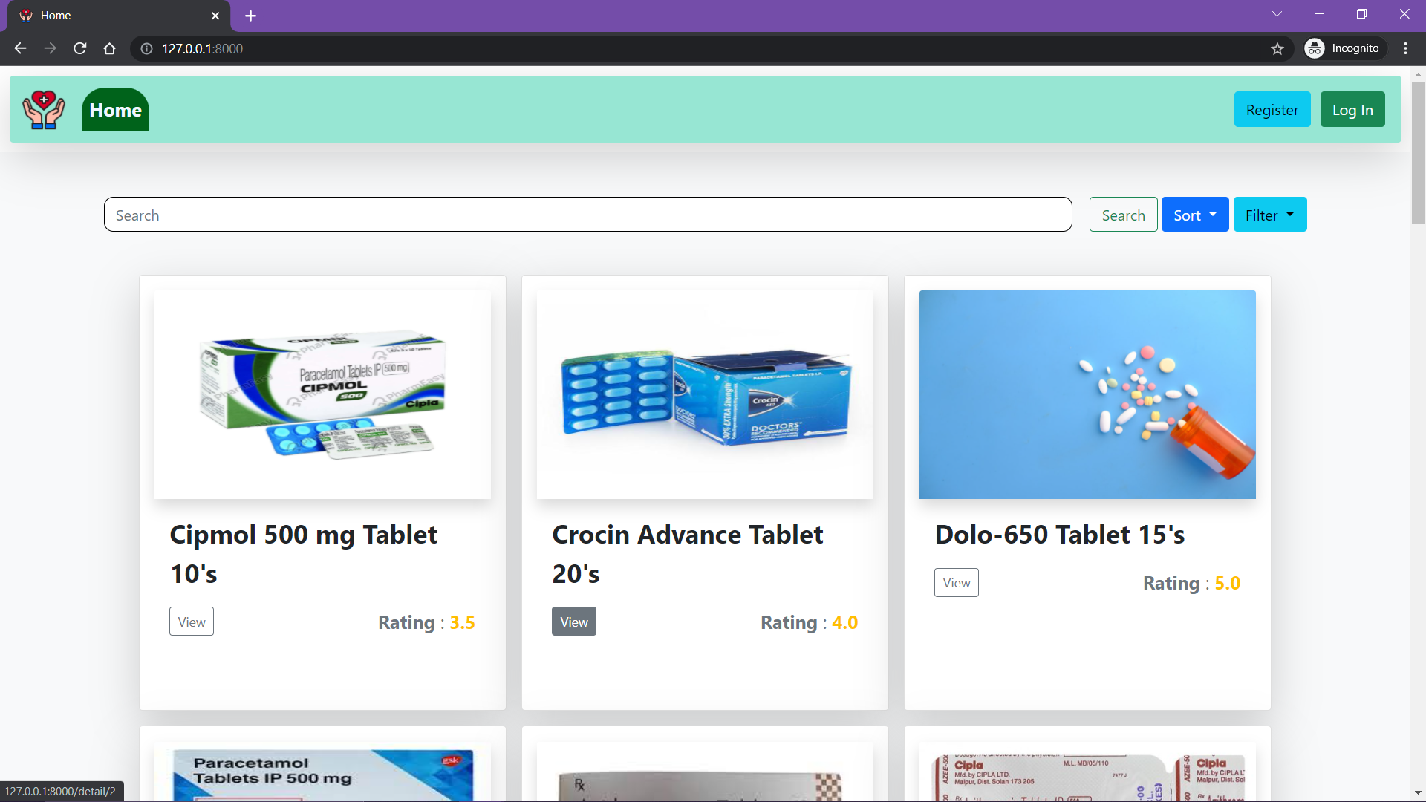
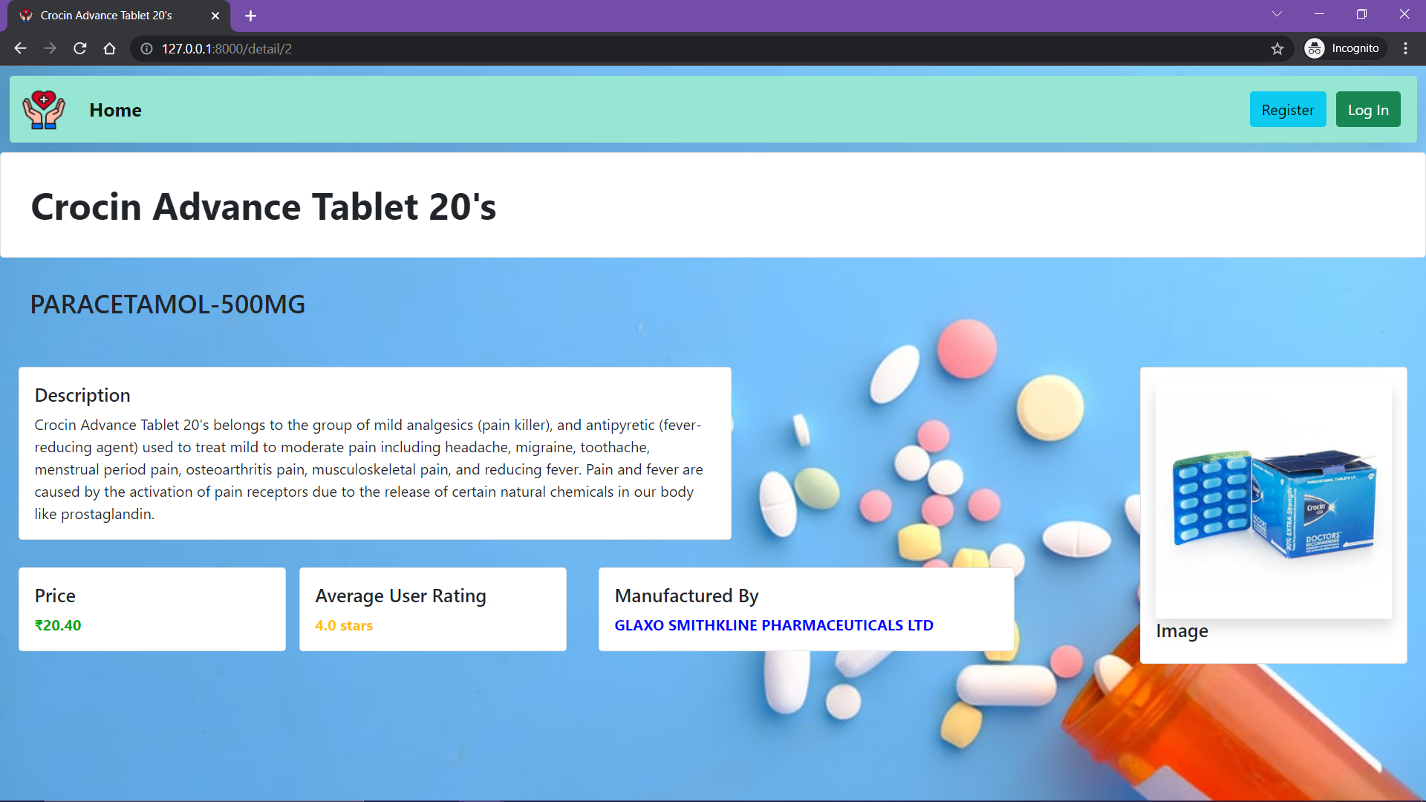
FEATURE 2 : DETAILED VIEW OF MEDICINE
Click Here

Slide 13
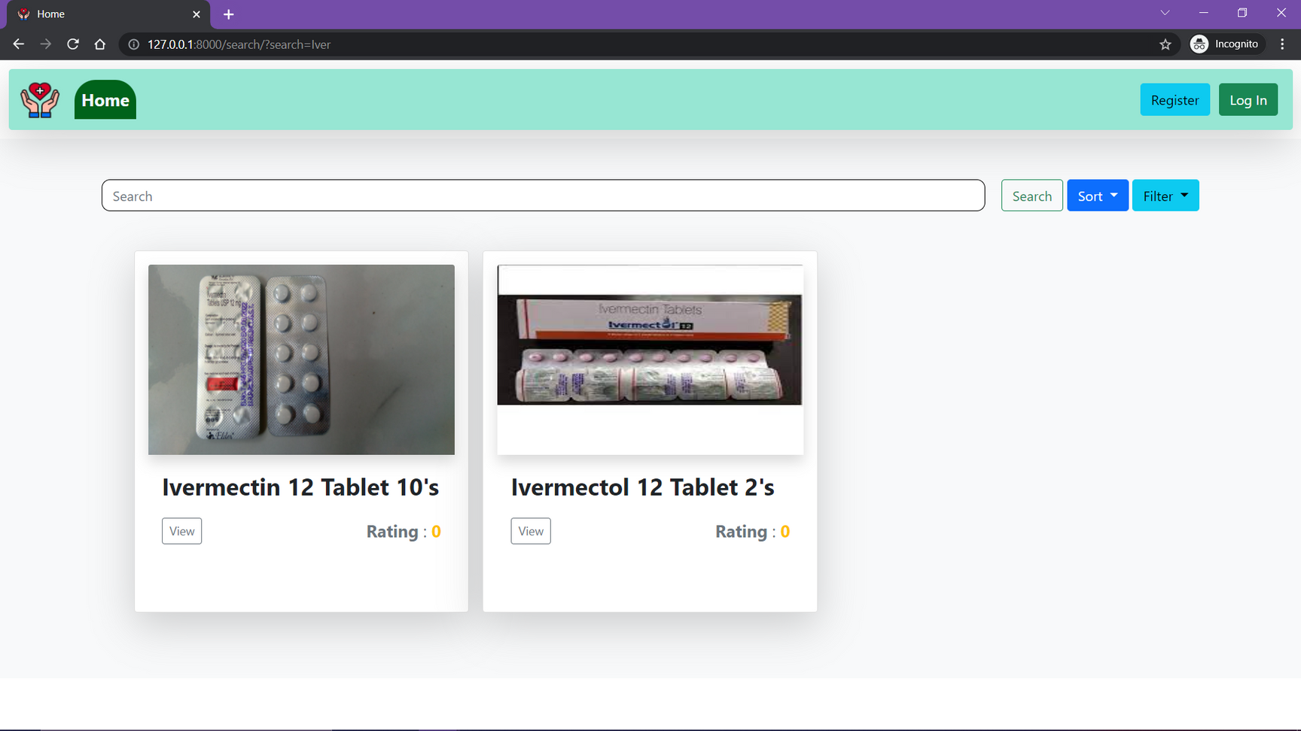
FEATURE 3 : SEARCH ON MEDICINES
Search Term: Iver

Slide 14
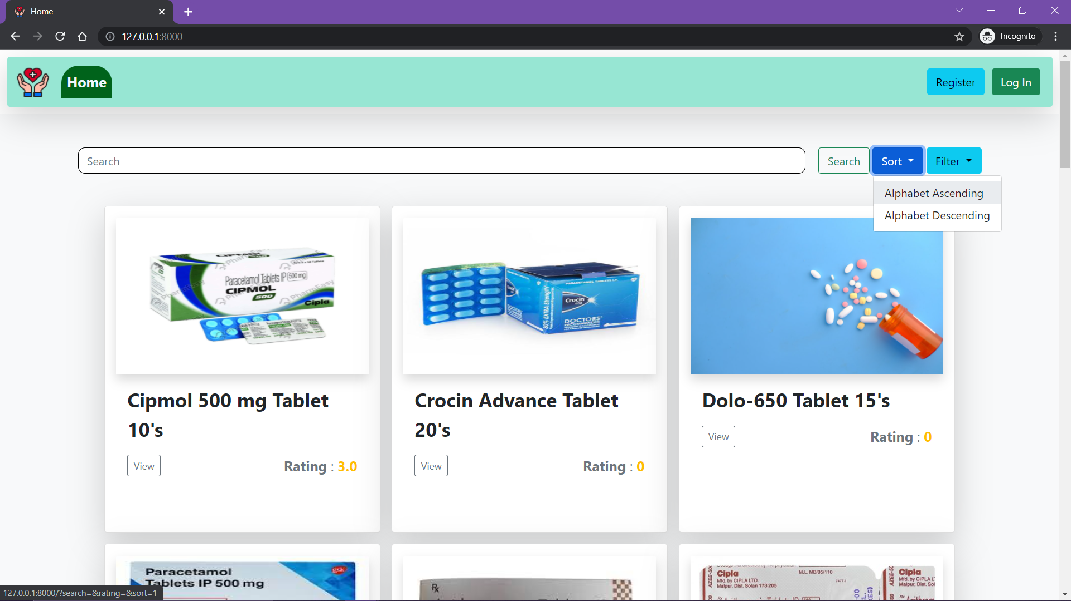
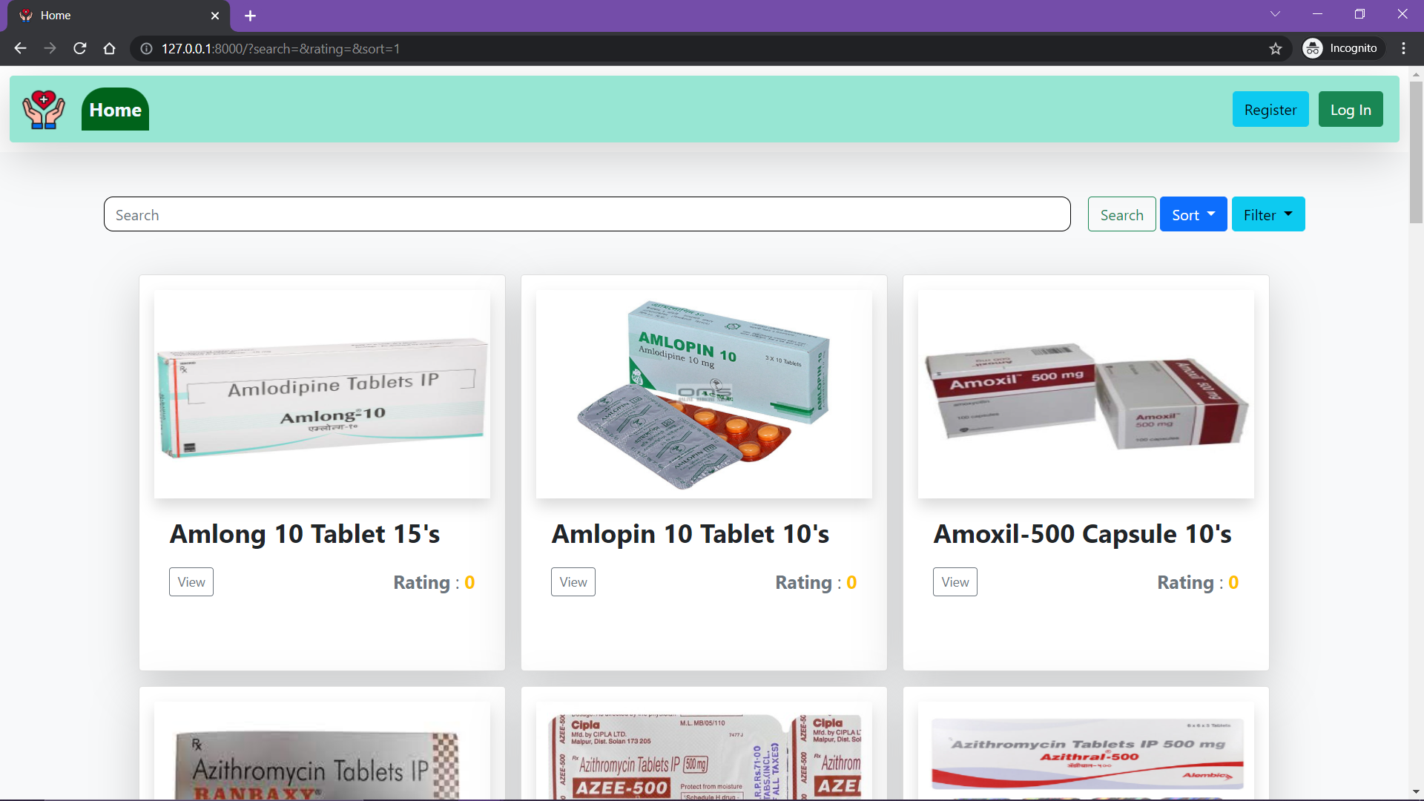
FEATURE 4 : SORT MEDICINES

Slide 15
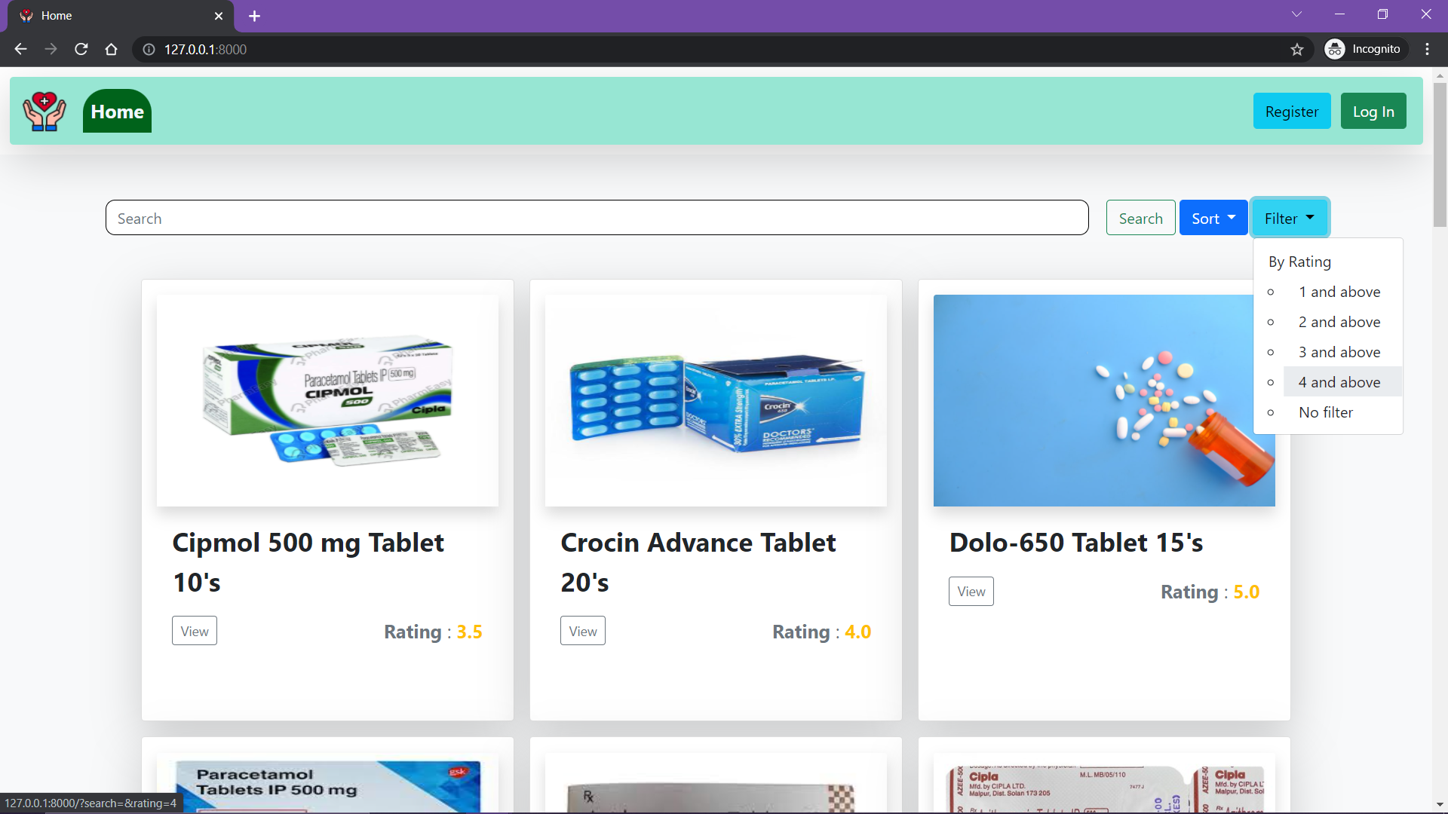
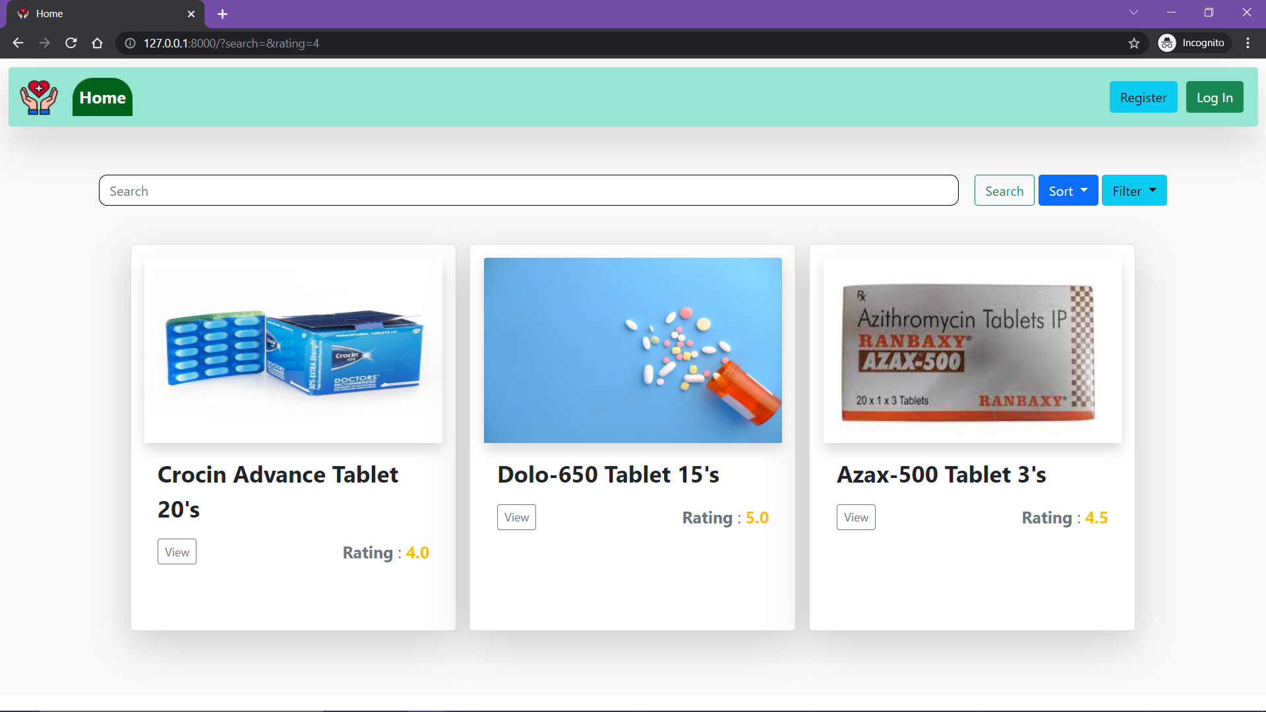
FEATURE 5 : FILTER MEDICINES

Slide 16
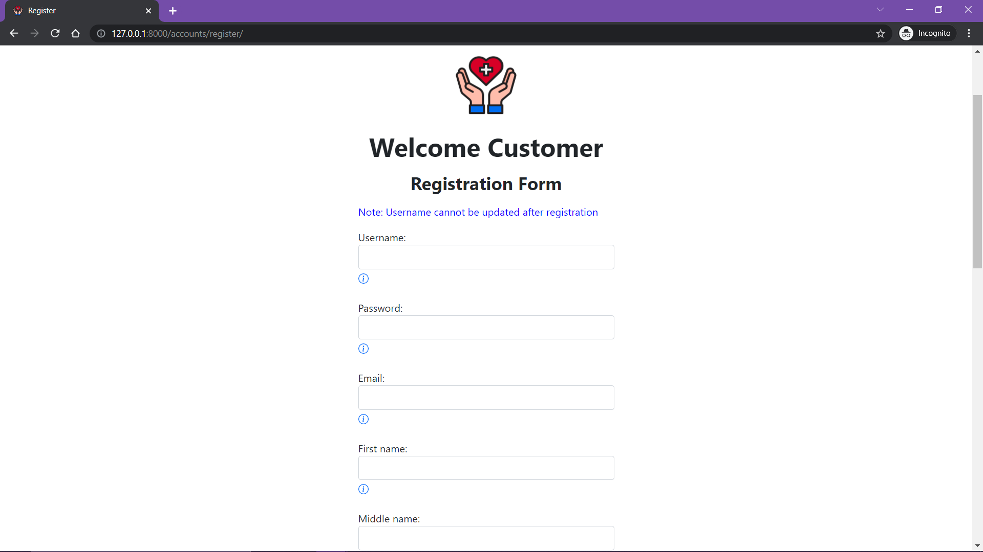
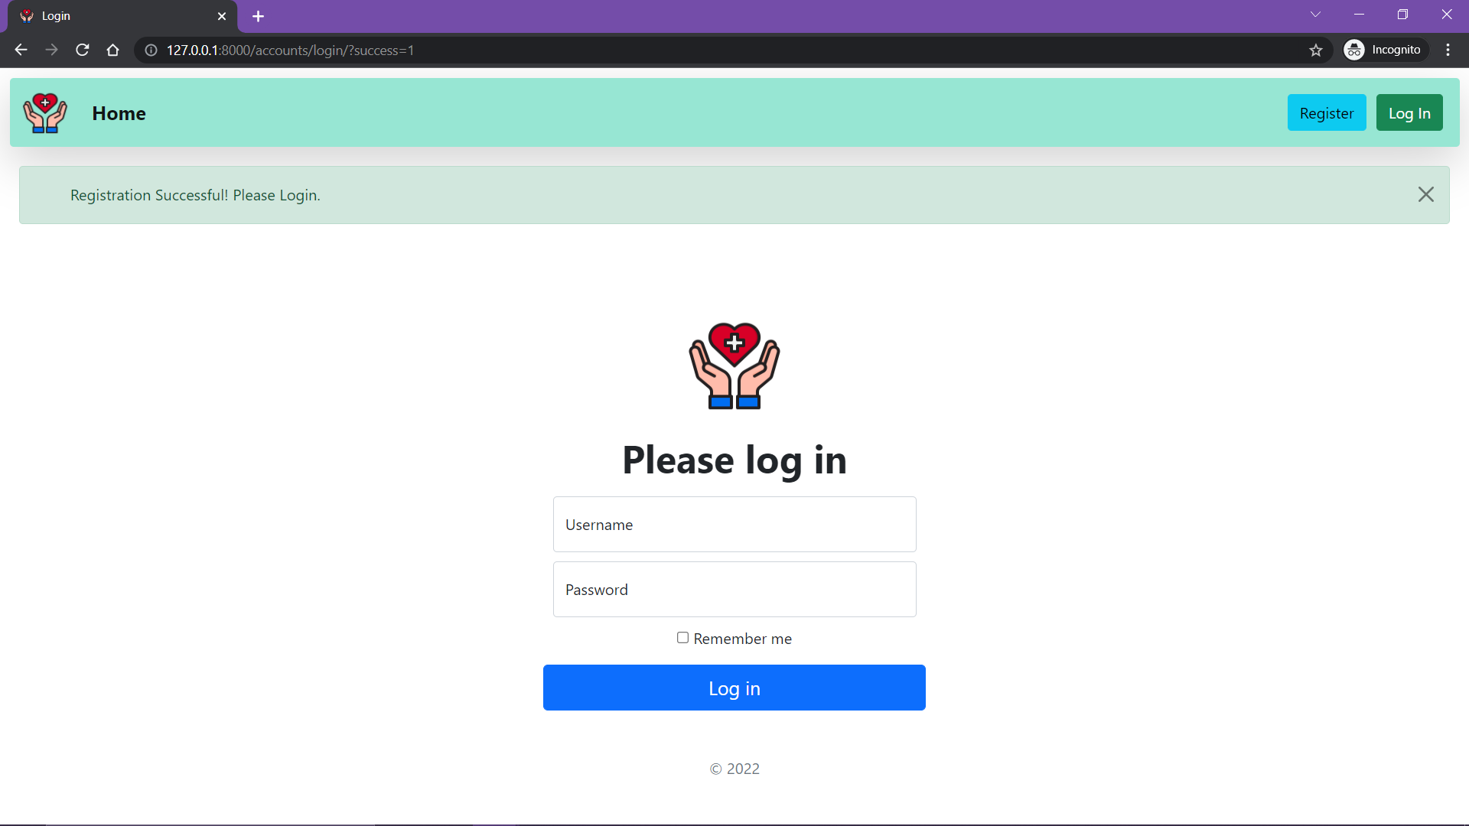
FEATURE 6 : REGISTER

Slide 17
CUSTOMER VIEW
In the following slides all the features accessible to a customer are explained in detail.
Note: A customer can do everything that the general public can do and more. For an individual to be qualified as a customer, they need to register first.

Slide 18
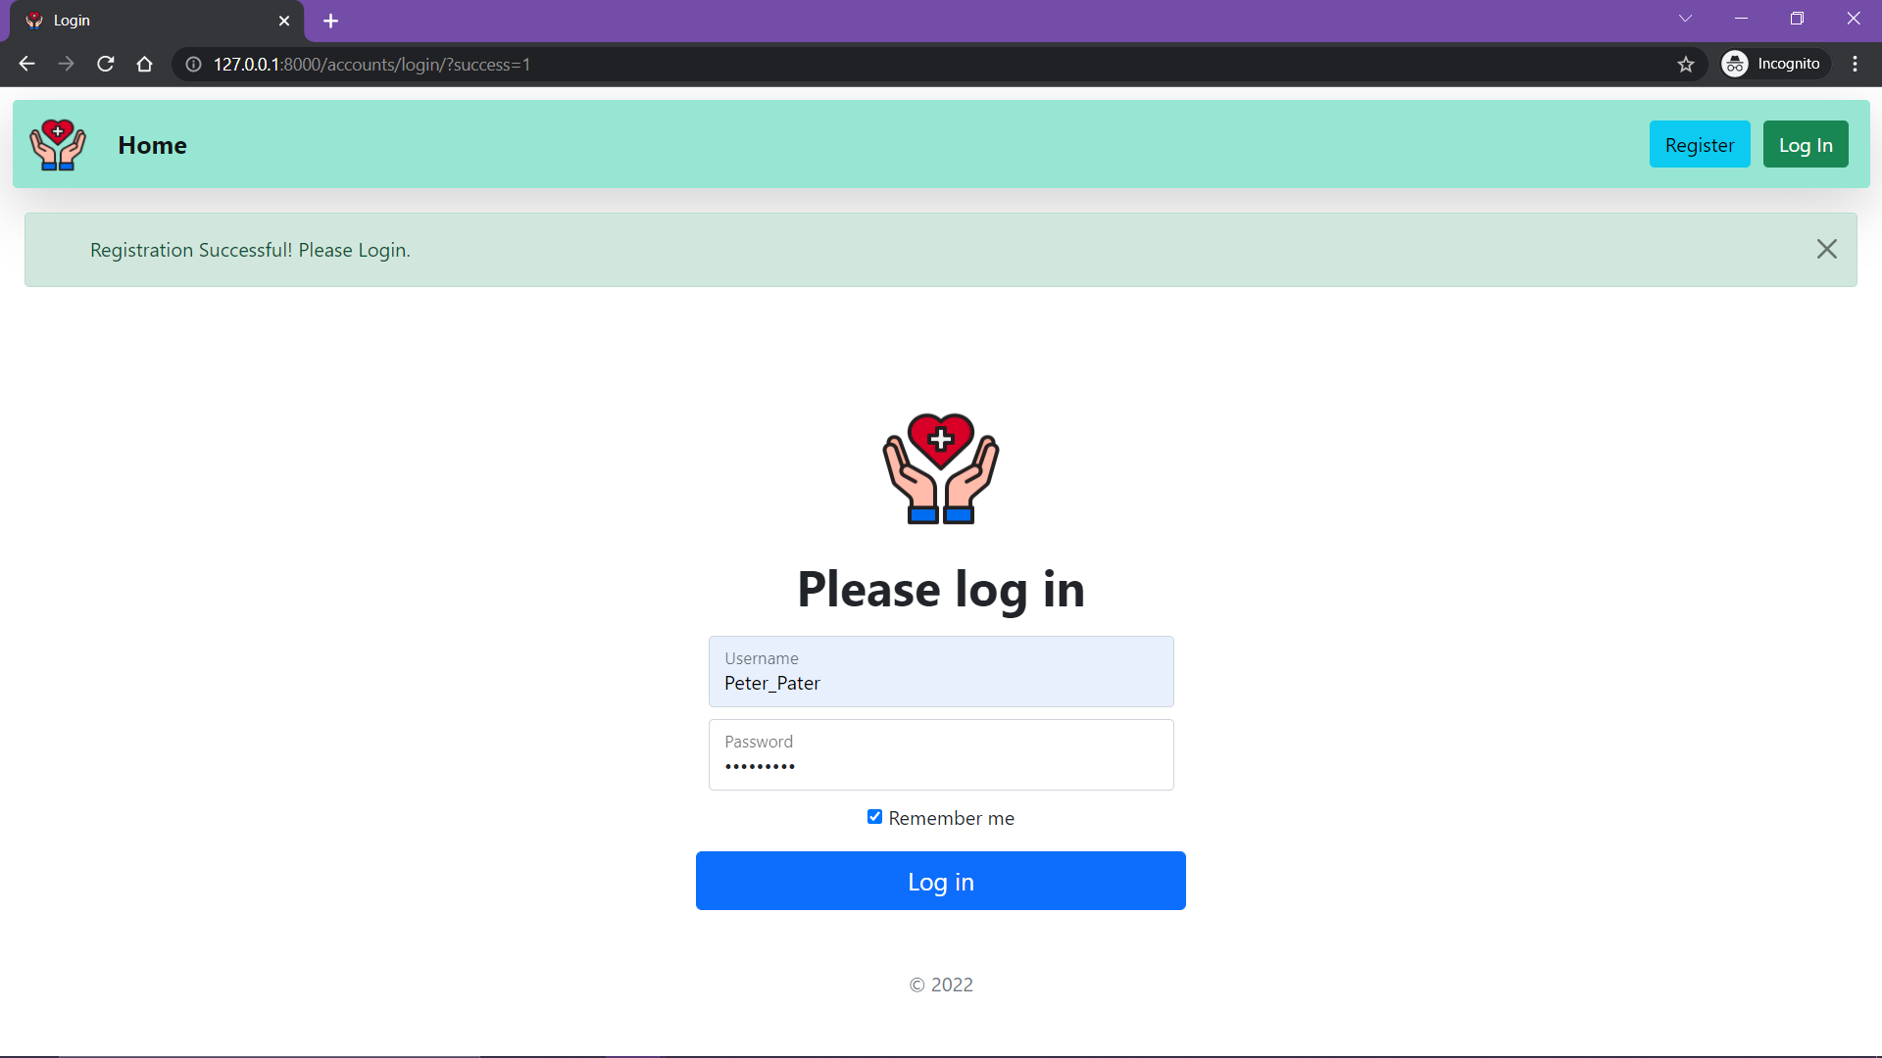
FEATURE 7 : LOG IN

Slide 19
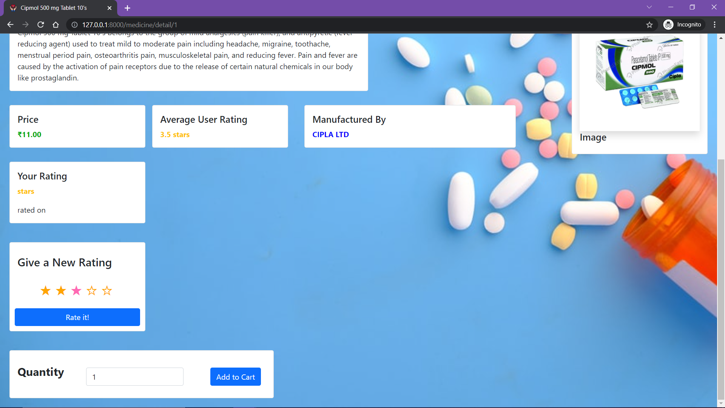
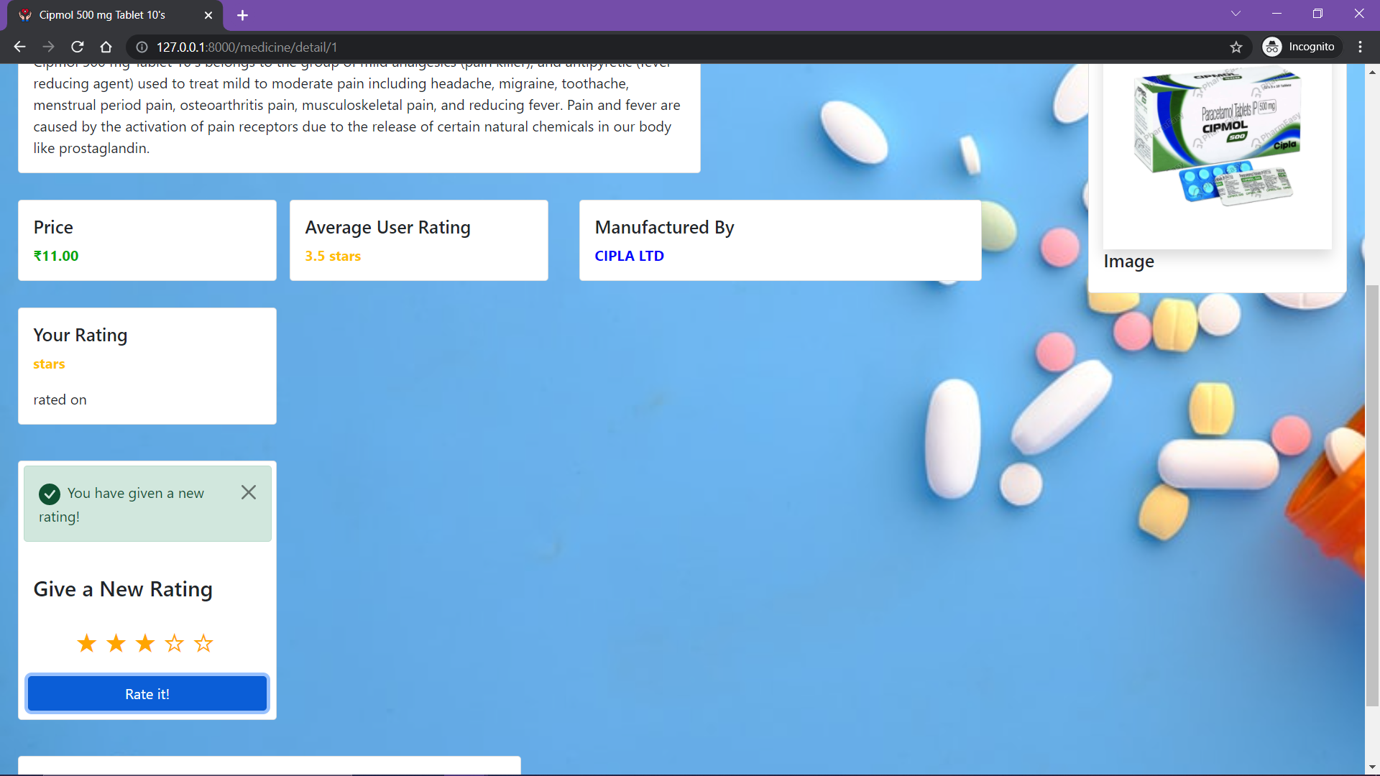
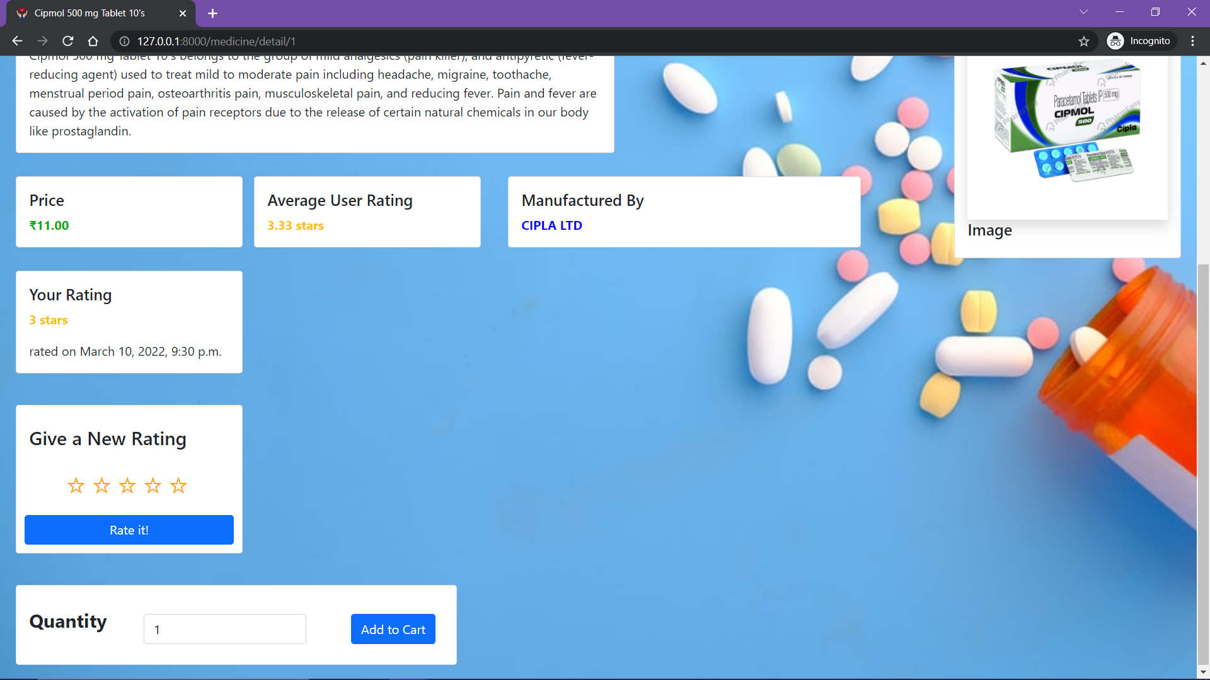
FEATURE 8 : RATE A MEDICINE
Select a rating
Your rating will appear here

Slide 20

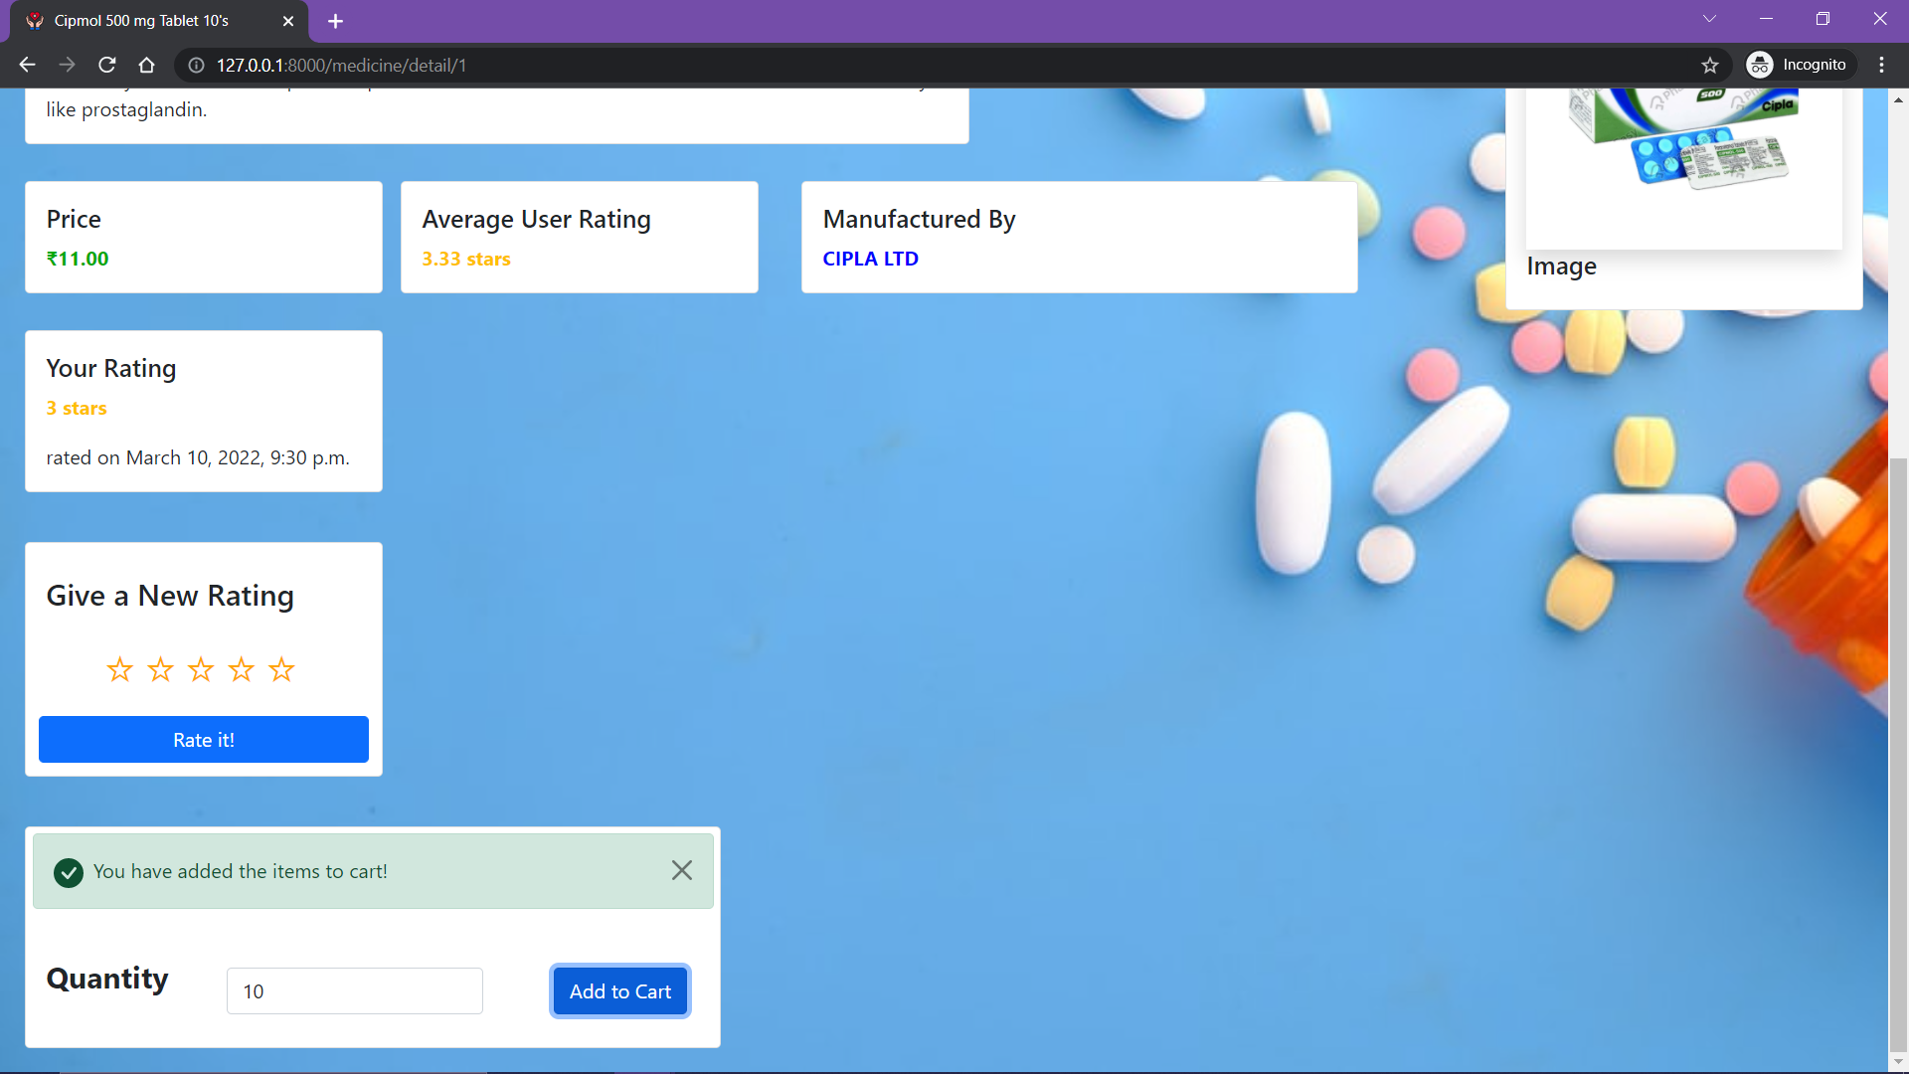
FEATURE 9 : ADD MEDICINE TO CART
Enter a valid quantity

Slide 21
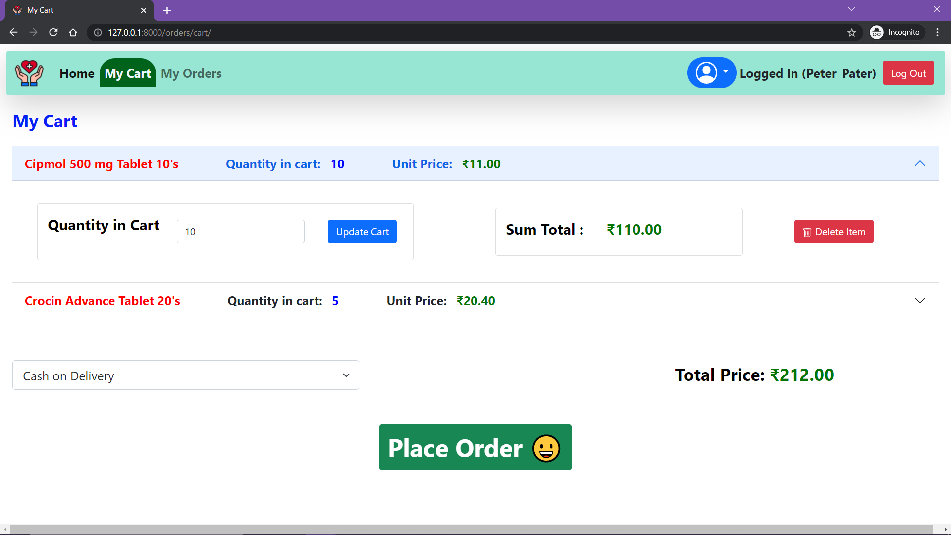
FEATURE 9 : VIEW AND UPDATE CART
View Cart
Change the quantity and update cart
Delete the whole item

Slide 22
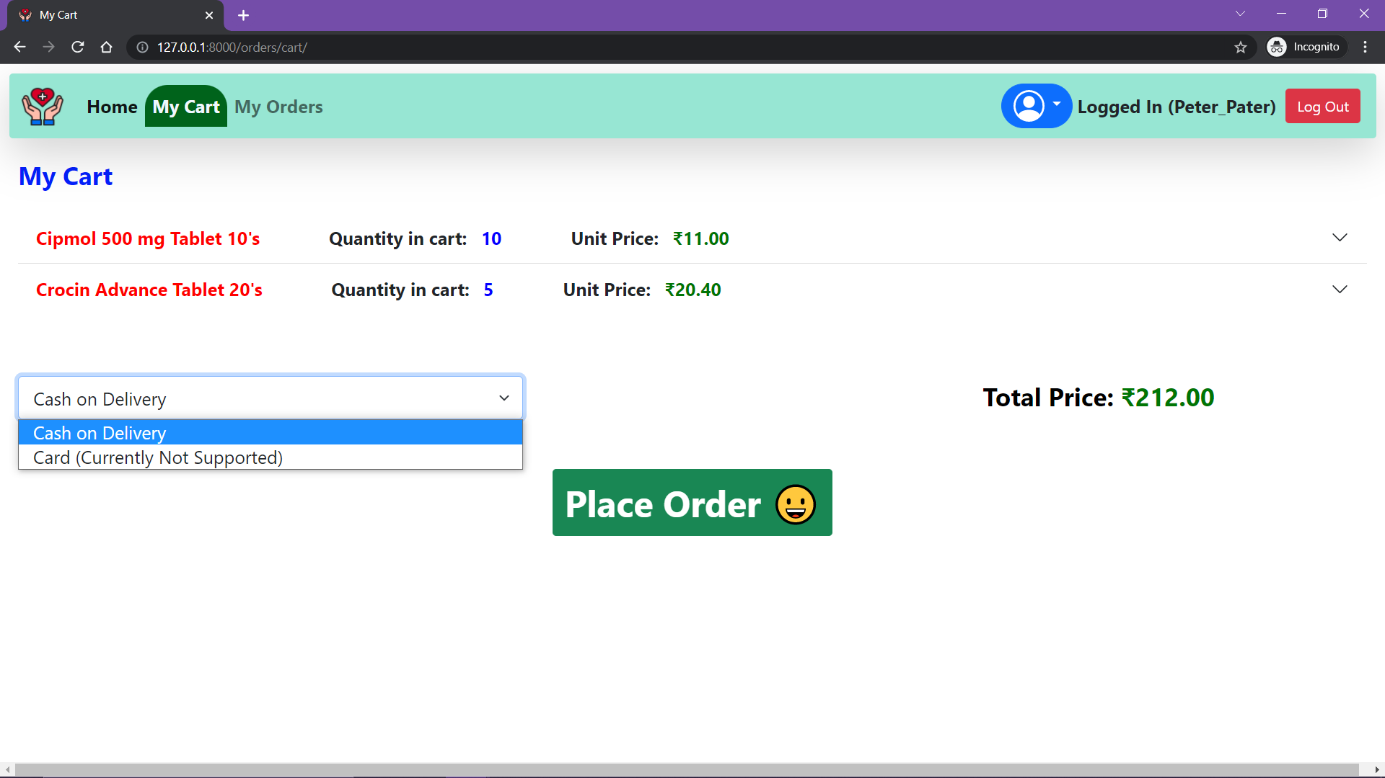
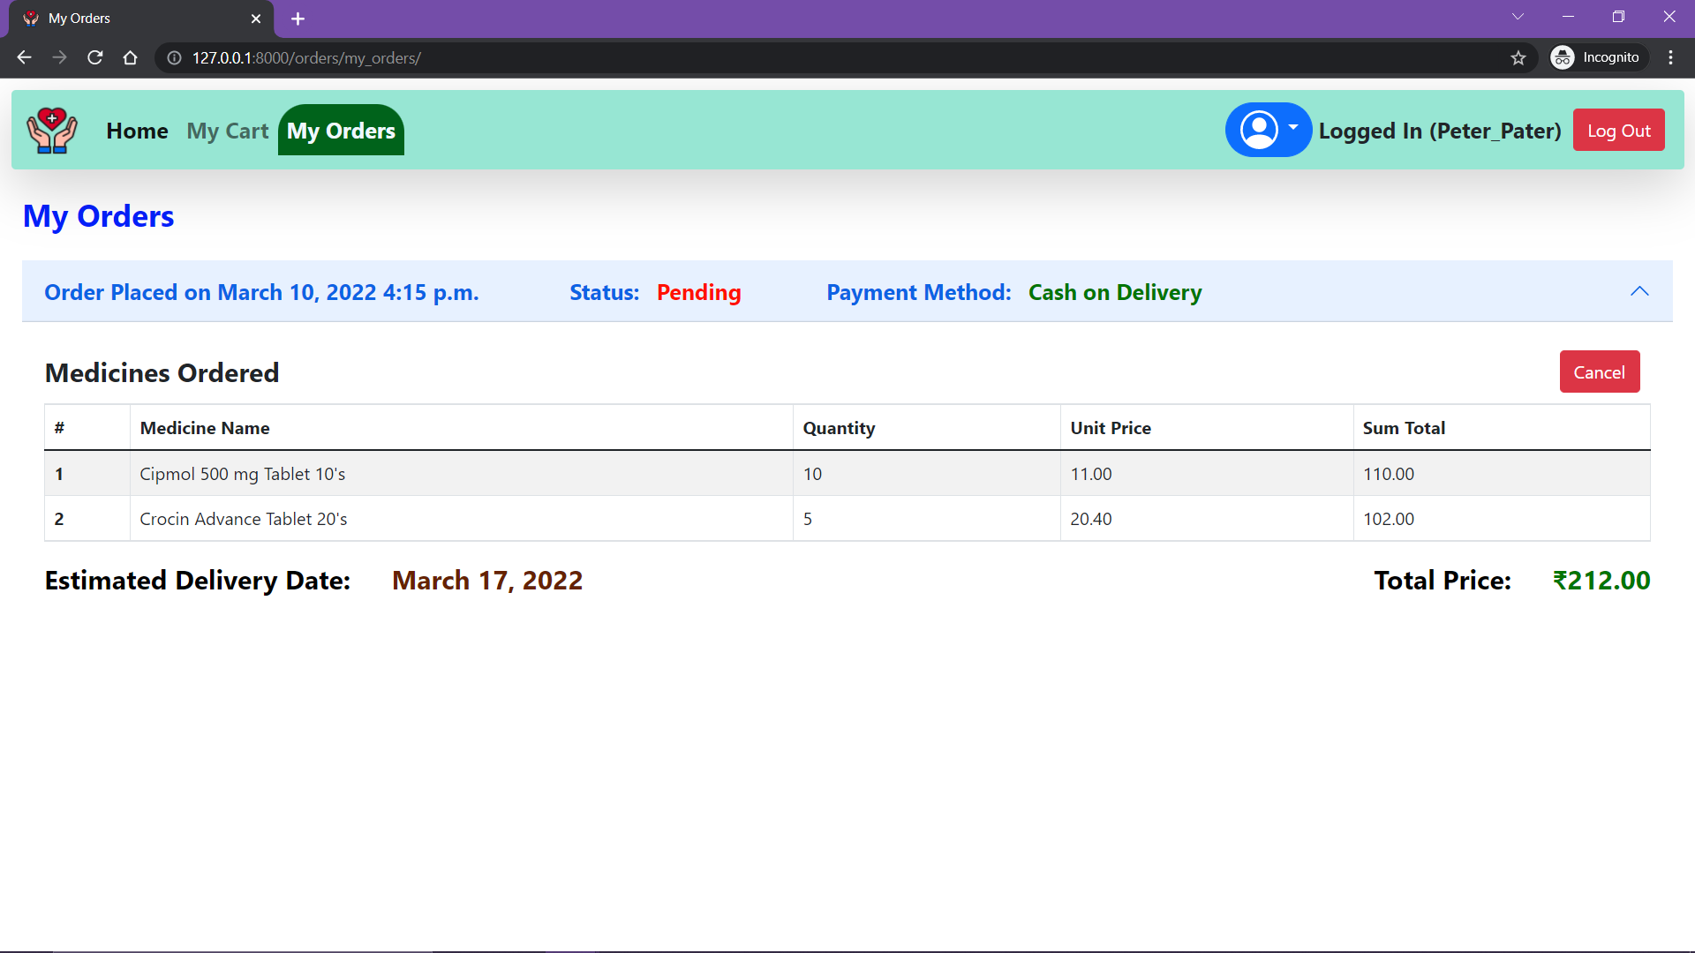
FEATURE 10 : CHOOSE A PAYMENT METHOD AND PLACE ORDER
Only Pending Orders can be cancelled
Choose a payment method
Place the Order

Slide 23
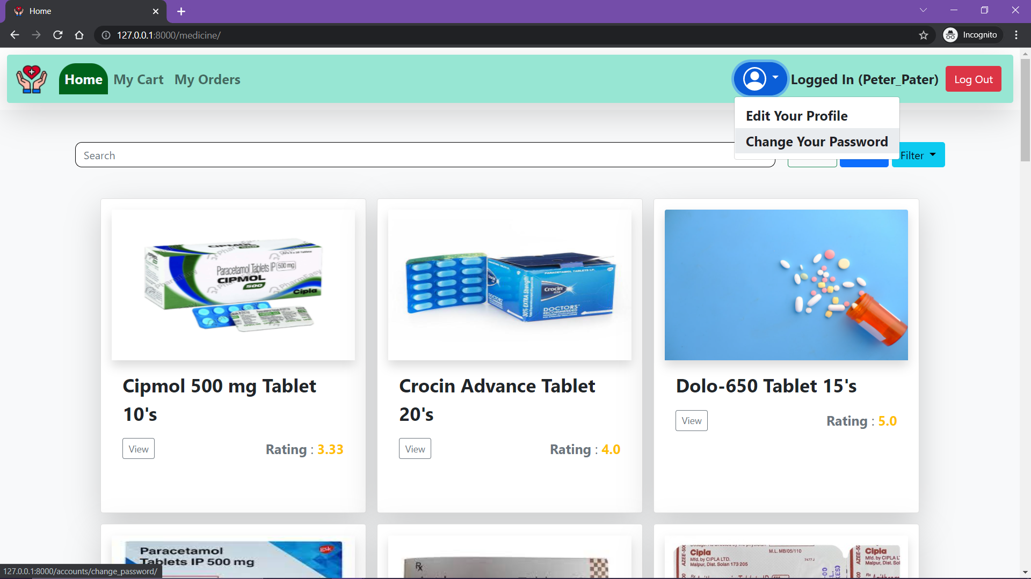
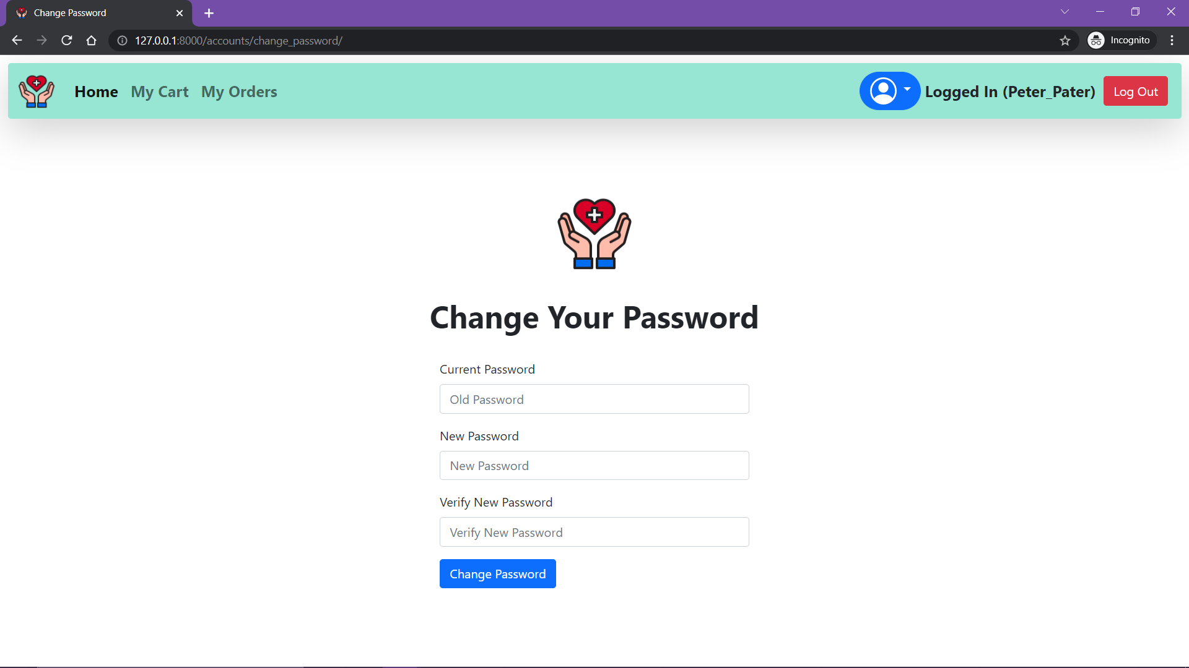
FEATURE 11 : CHANGE PASSWORD
Click Here

Slide 24
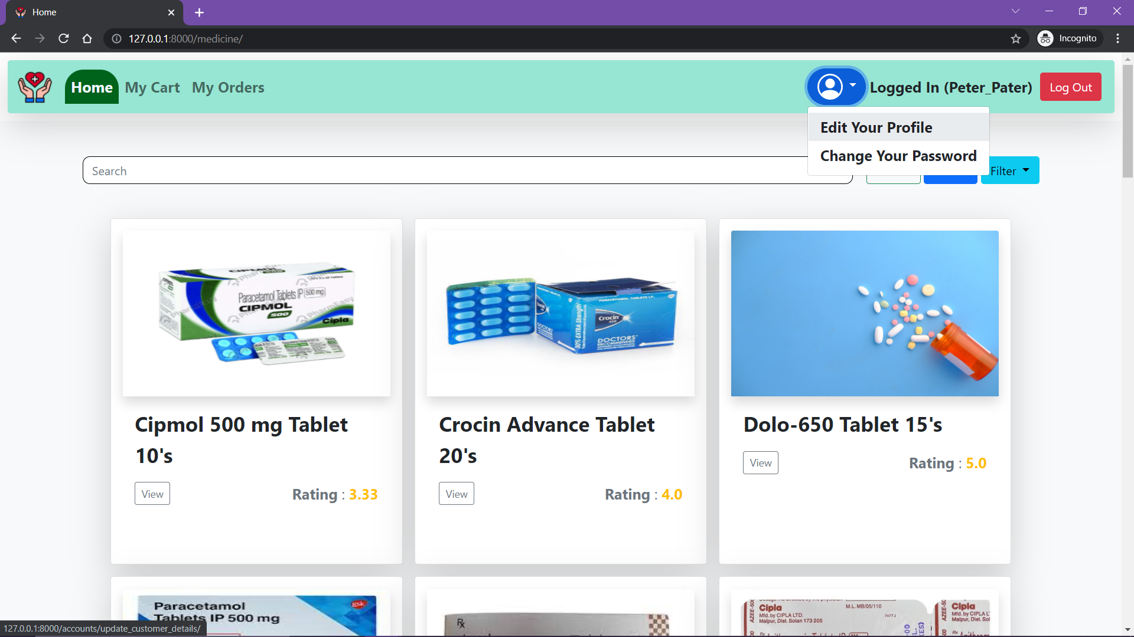
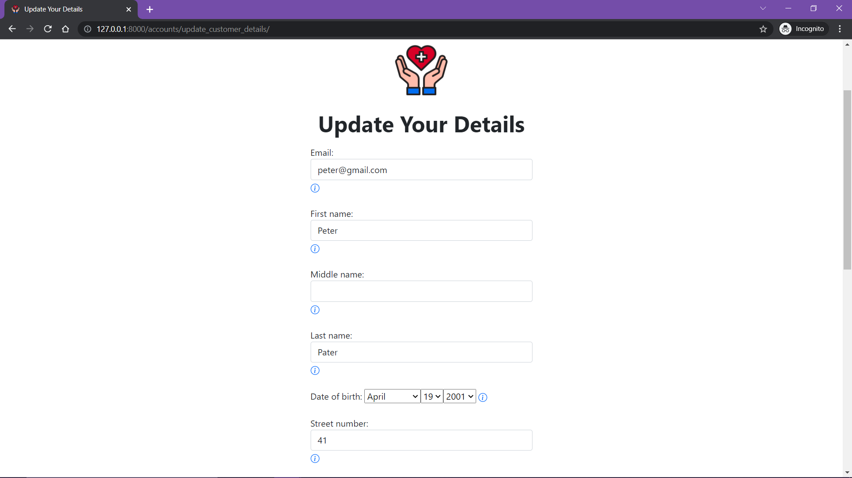
FEATURE 12 : EDIT YOUR PROFILE
Click Here

Slide 25
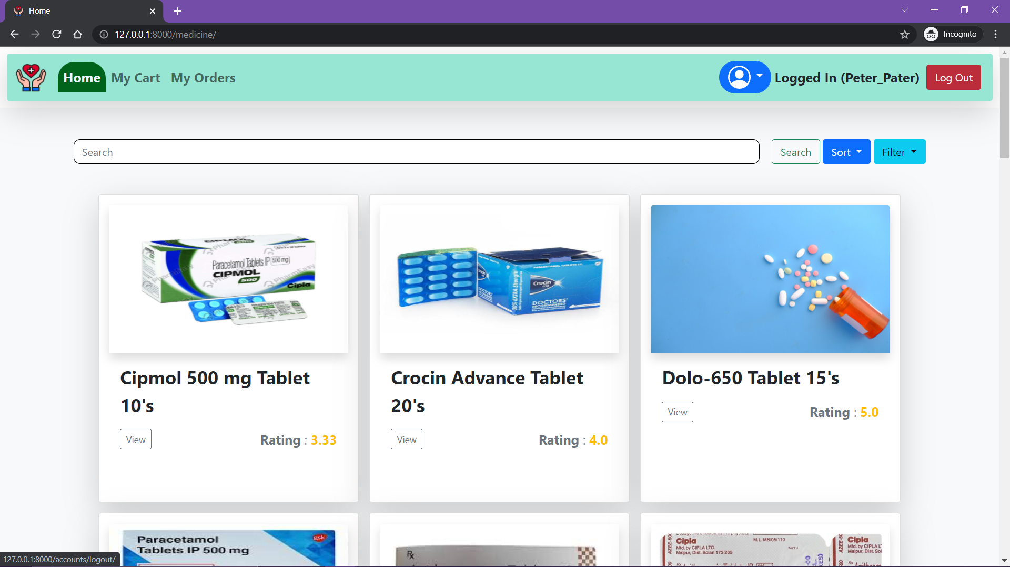
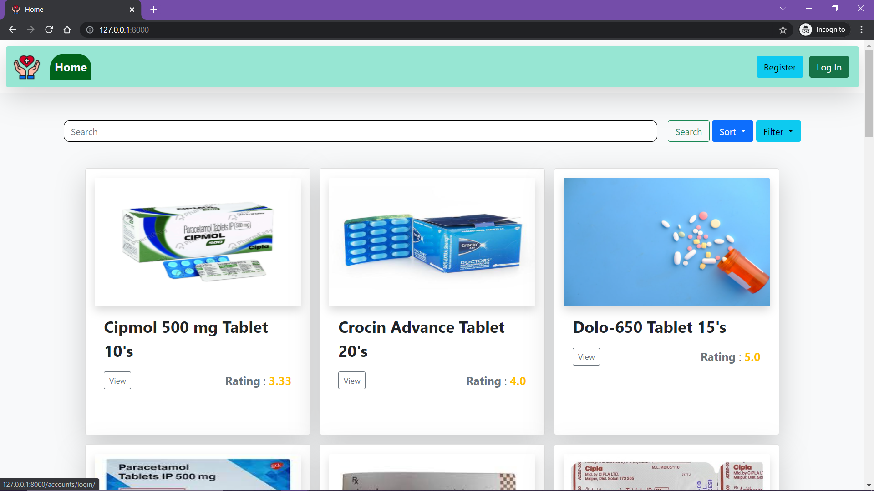
FEATURE 13 : LOG OUT
Click Here

Slide 26
STAFF VIEW
In the following slides all the features accessible to a staff member of the pharmacy are explained in detail.
Note: A staff can do everything that the general public can do and more. For an individual to be qualified as a staff the admin needs to register them first.

Slide 27
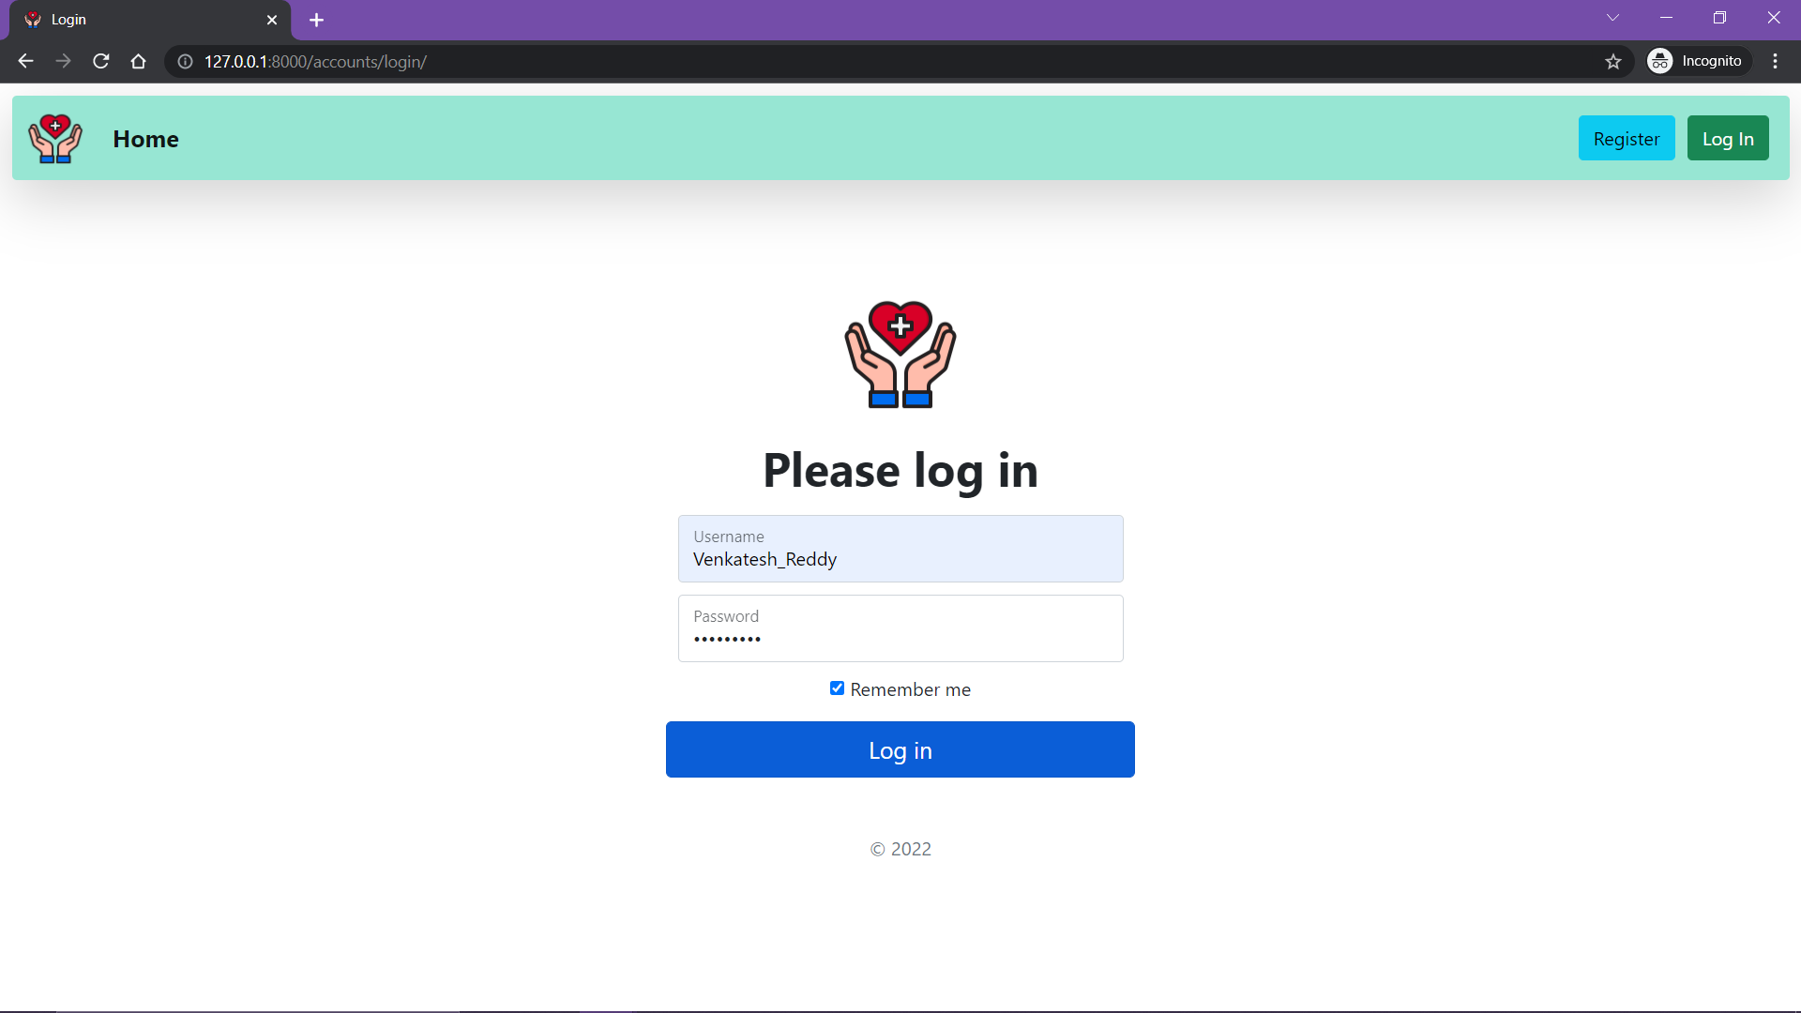
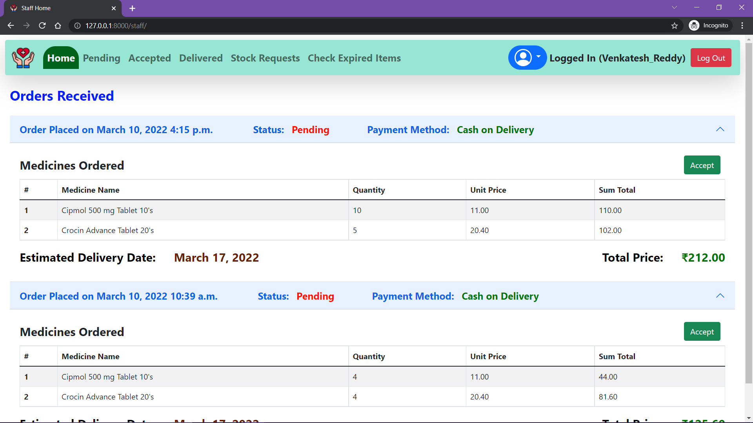
FEATURE 14 : LOG IN USING STAFF CREDENTIALS AND GET STAFF VIEW
Note the order Peter Pater placed

Slide 28
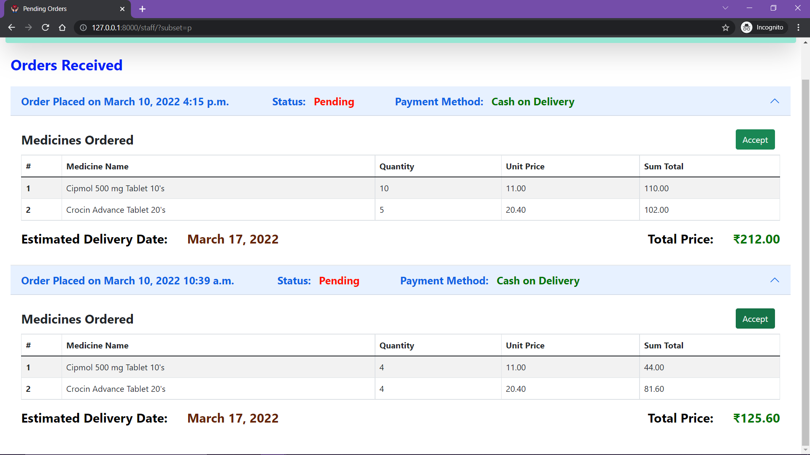
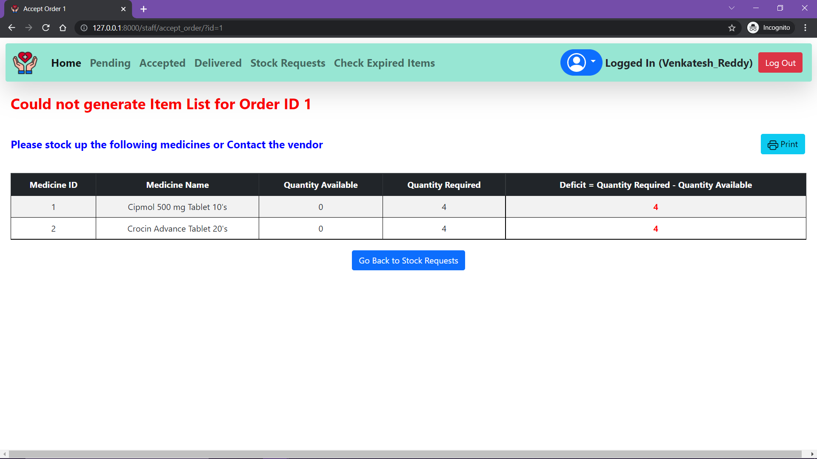
FEATURE 15 : TRY TO ACCEPT AN ORDER BUT NO STOCK AVAILABLE
Click Here

Slide 29
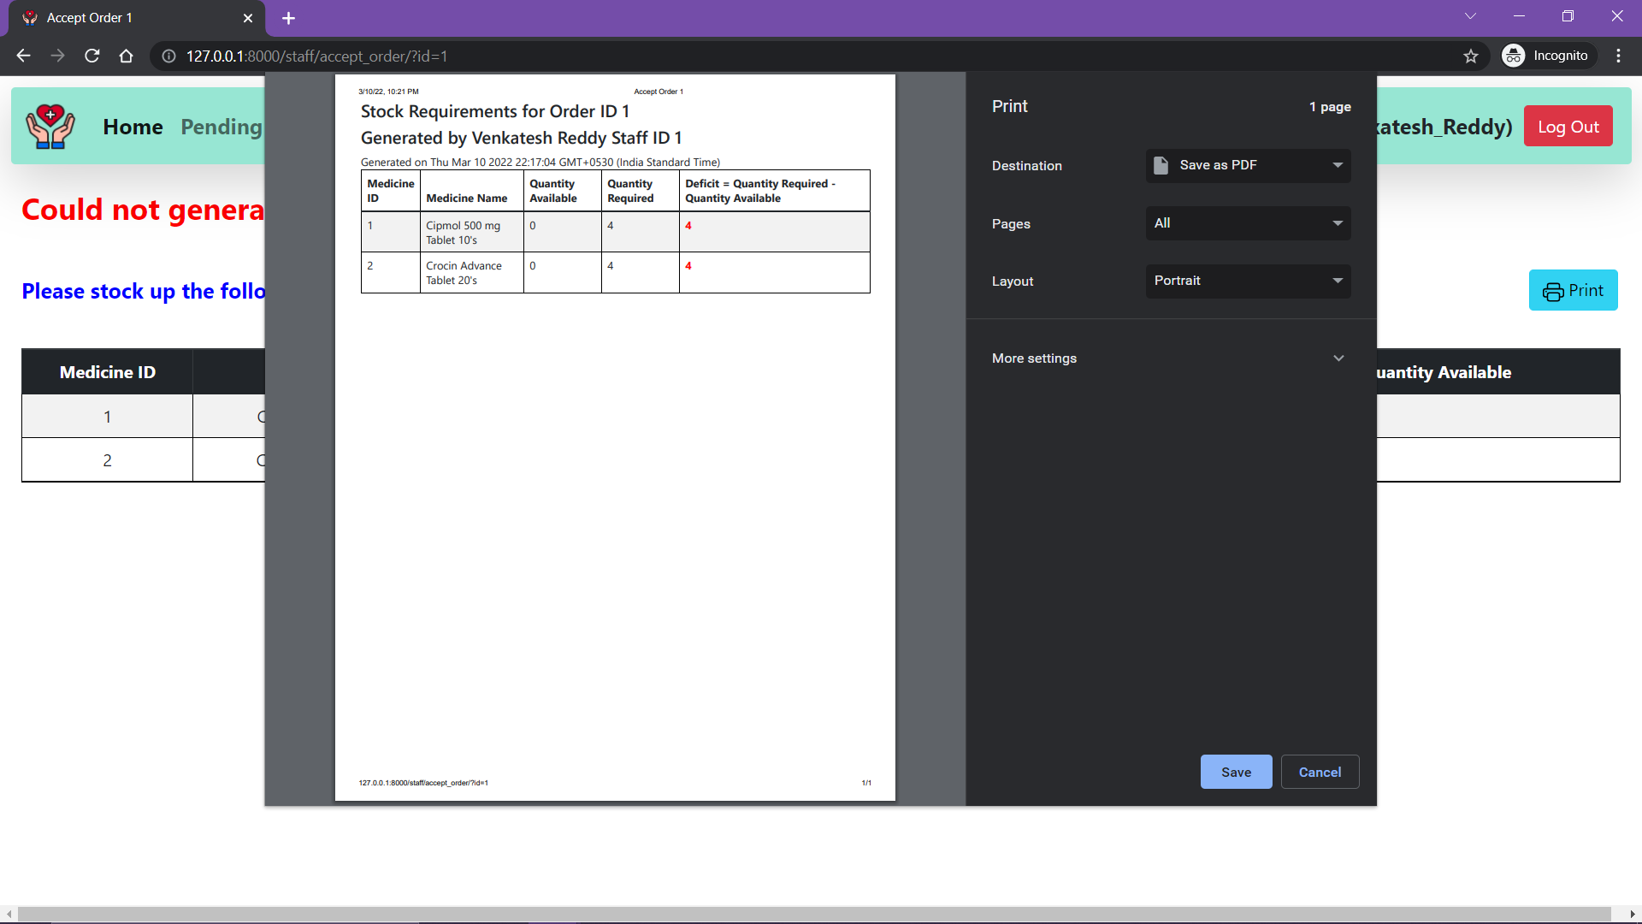
FEATURE 16 : GET THE PRINTED COPY OF REQUIRED ITEMS
Click Here

Slide 30
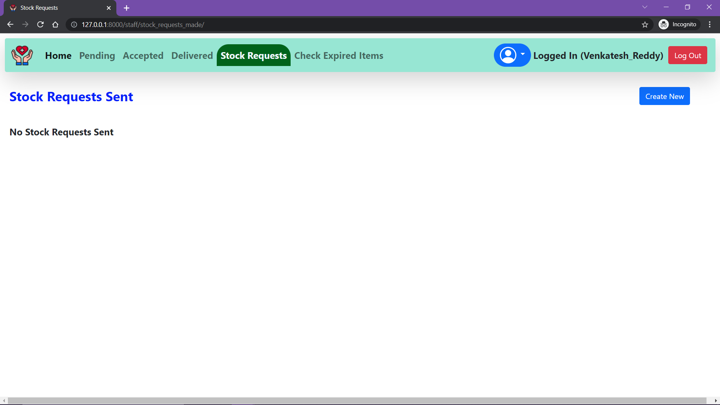
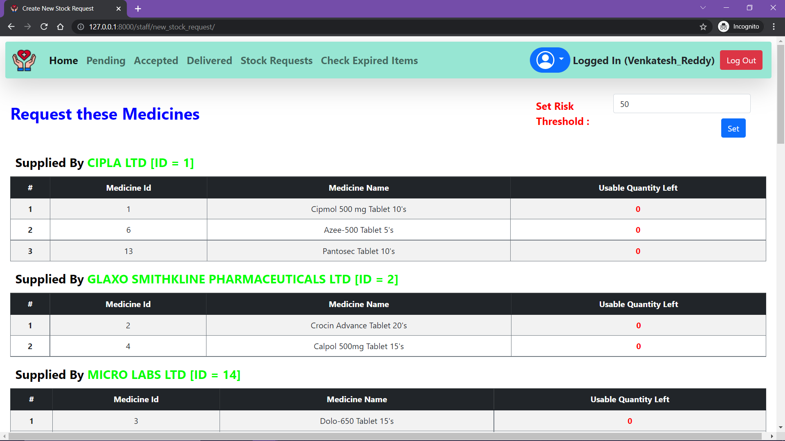
FEATURE 17 : ISSUE A STOCK REQUEST FROM VENDOR
Go to this tab
Then Click Here

Slide 31
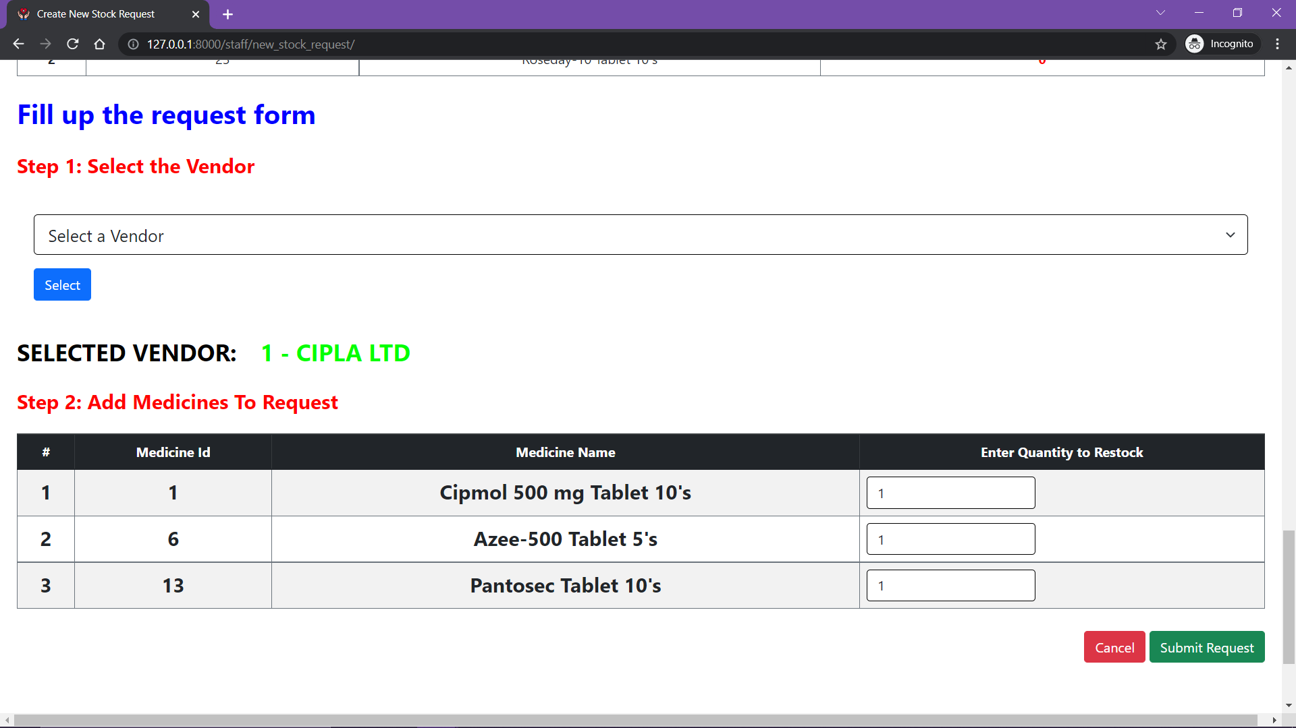
FEATURE 17 : ISSUE A STOCK REQUEST FROM VENDOR [CONT.D]
I need 4 Cipmol and Crocin to accept that customer’s order
Scroll down and select the vendor to whom you want to send the request. I have selected CIPLA who supplies Cipmol. Do the same for all vendors whom you want to re-stock from.
The page, by default, shows the medicines whose quantity is less than the Risk Threshold. This quantity can be set.

Slide 32

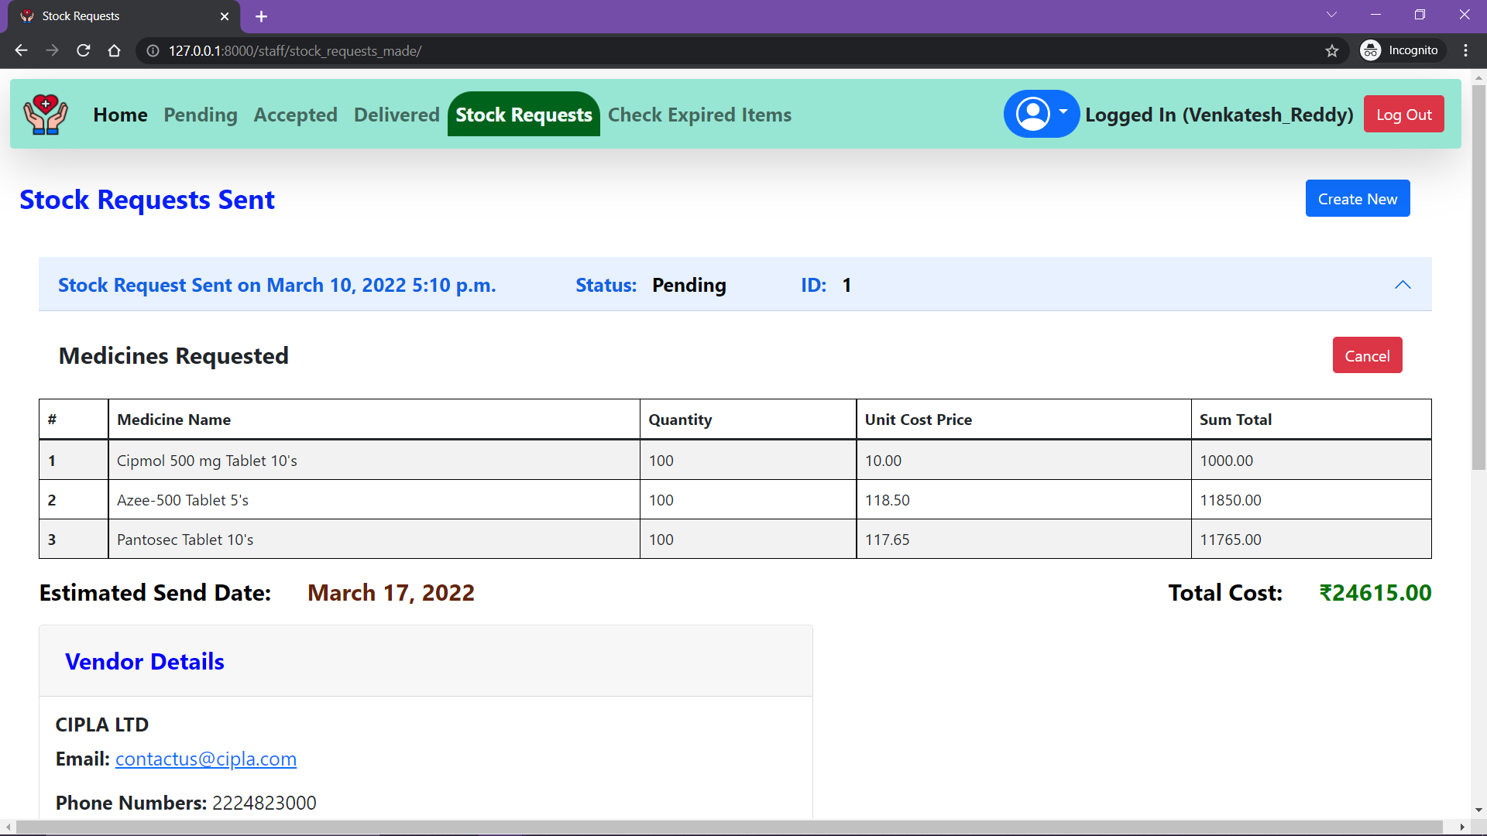
FEATURE 17 : ISSUE A STOCK REQUEST FROM VENDOR [CONT.D]
Set the quantities and place the order. Do the same for Crocin
The stock requests we just made appears here.

Slide 33
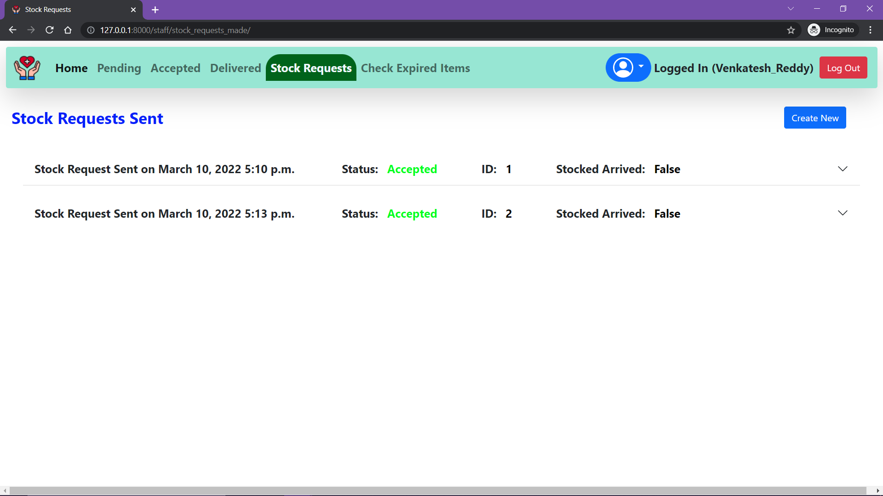
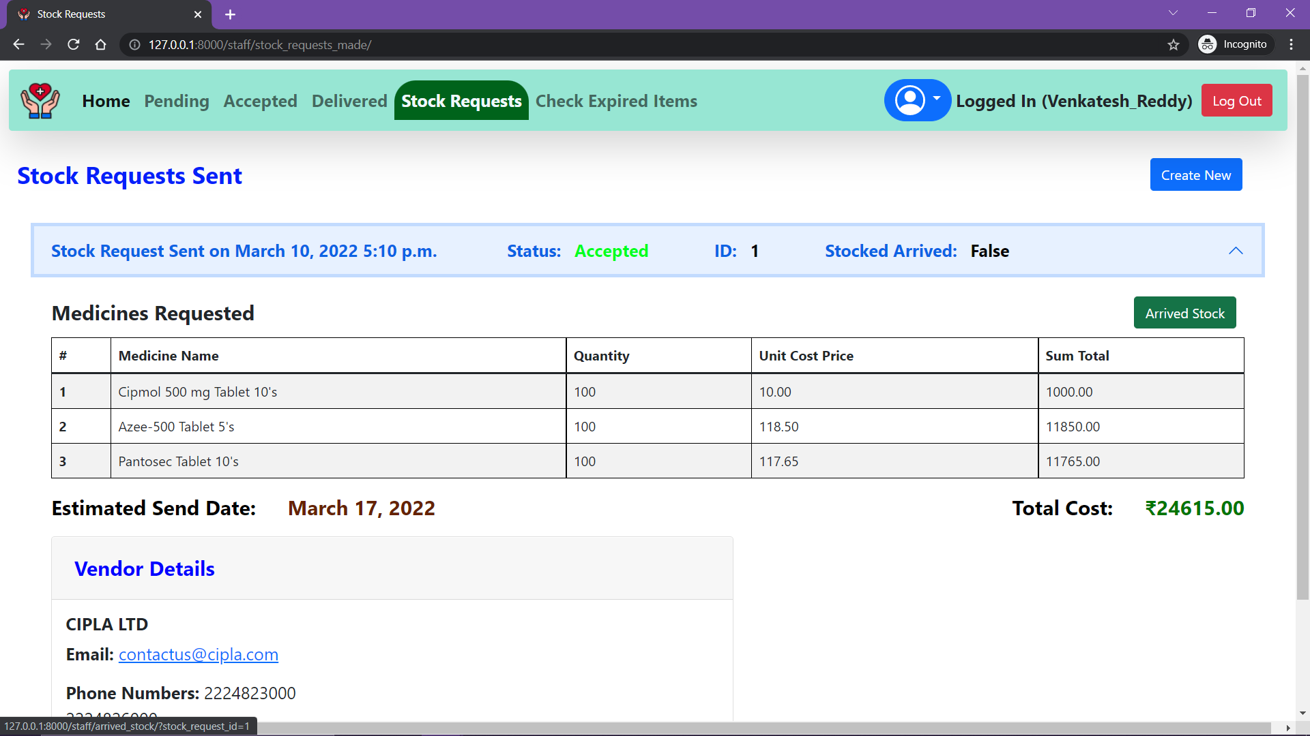
FEATURE 18 : VENDOR ACCEPTS THE STOCK REQUESTS AND SENDS THE STOCK
If the stock has arrived click here.

Slide 34
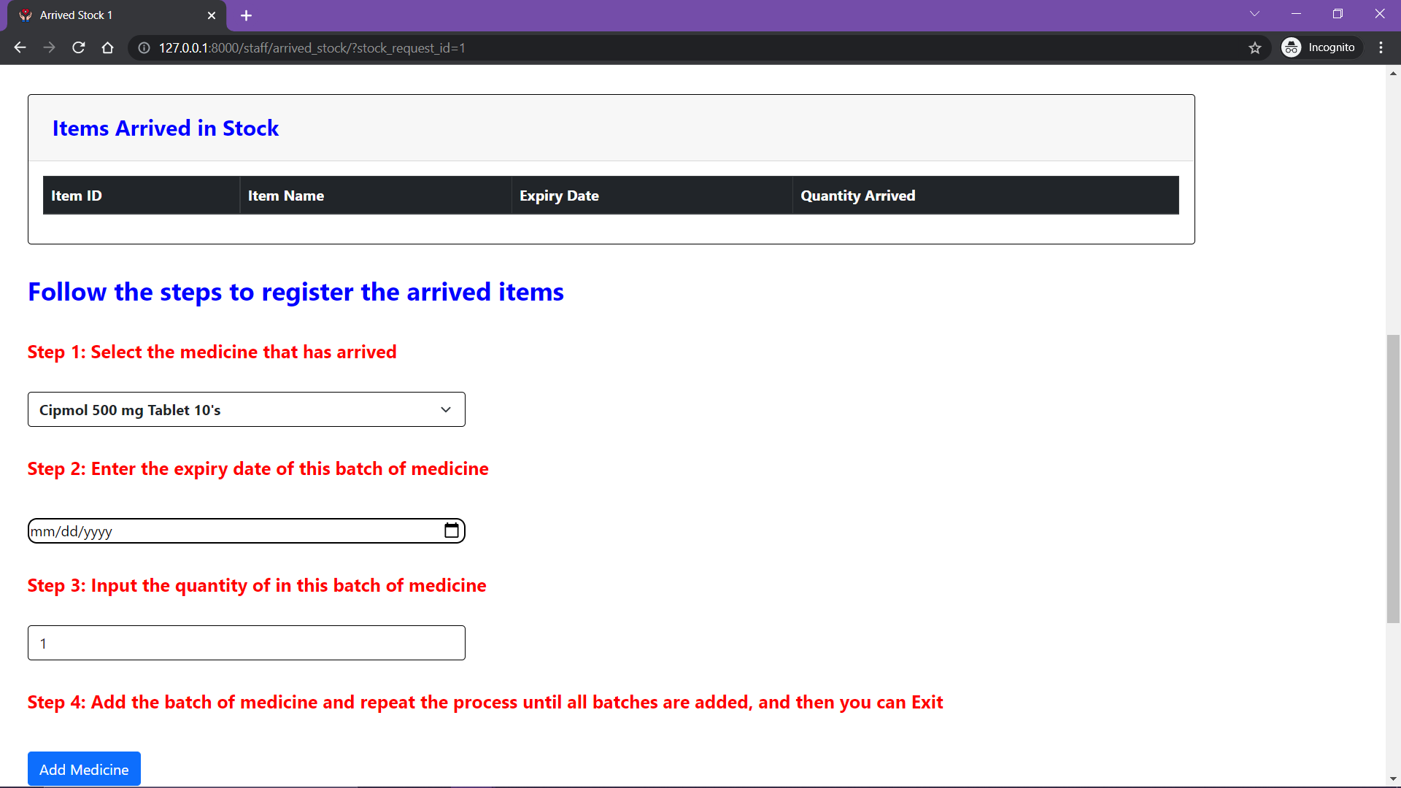
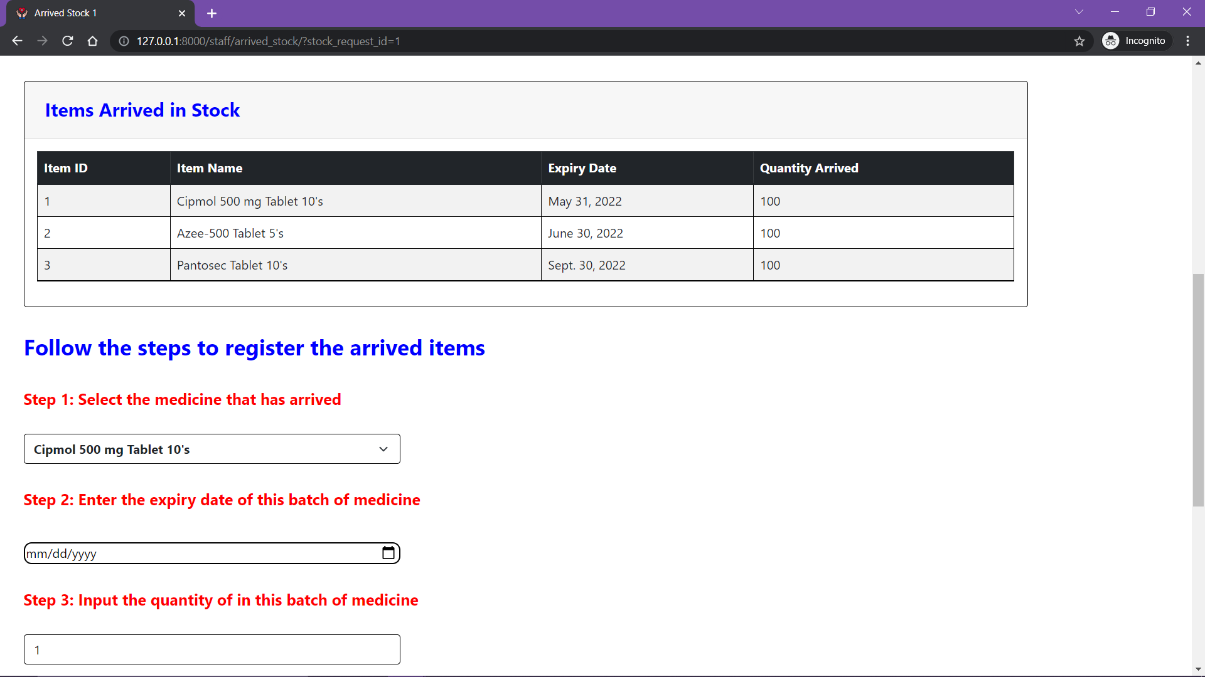
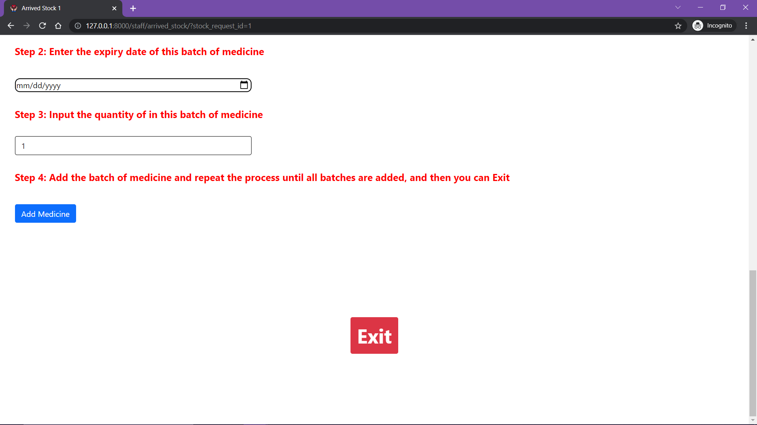
FEATURE 19 : REGISTER THE ARRIVED STOCK
If the stock has arrived click here.
Follow the steps and fill up the table above.
After Registering the arrived items exit

Slide 35
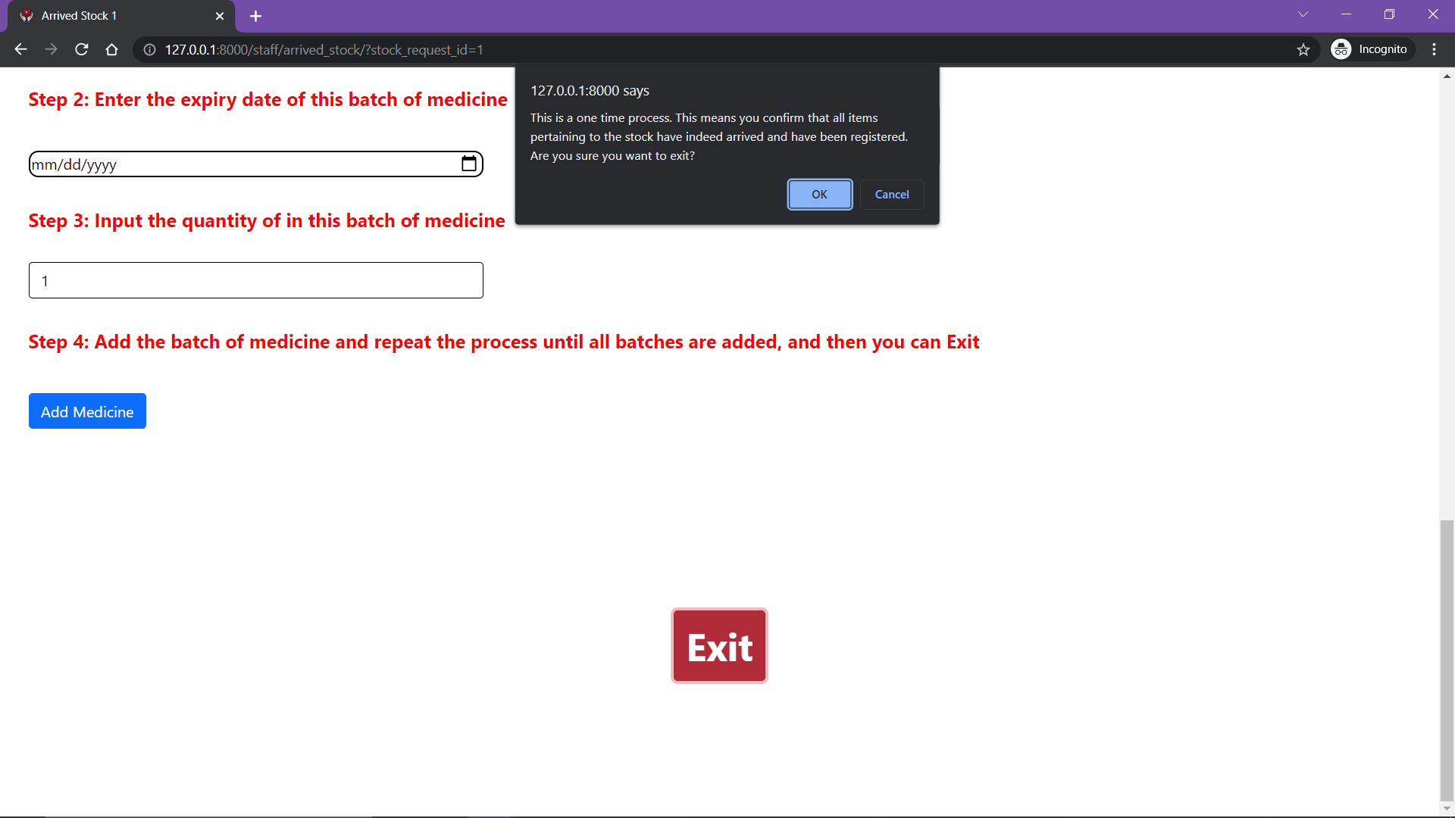
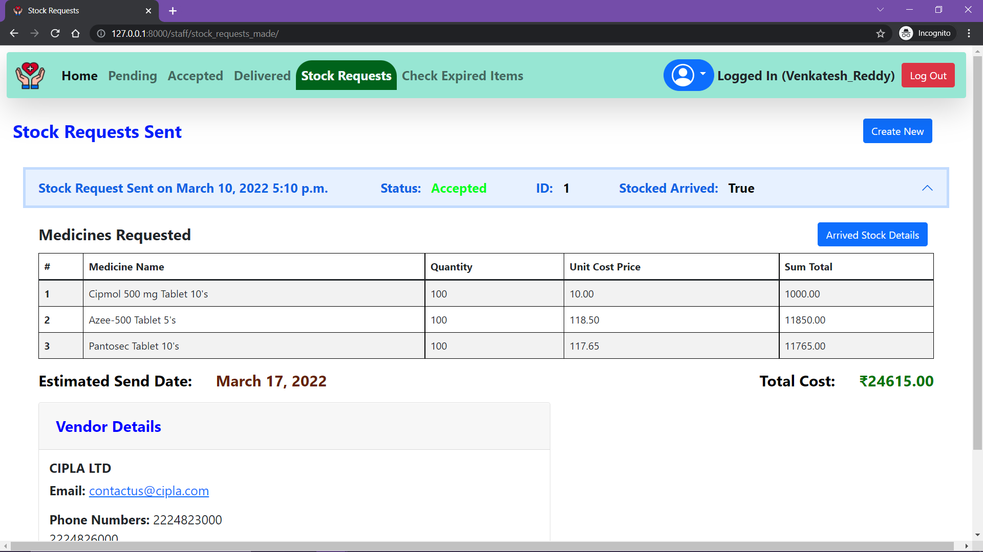
FEATURE 19 : REGISTER THE ARRIVED STOCK [CONT.D]
Once you have registered an arrived stock then you can only view the details of the stock but cannot edit the arrived items.
After Registering the arrived items exit

Slide 36
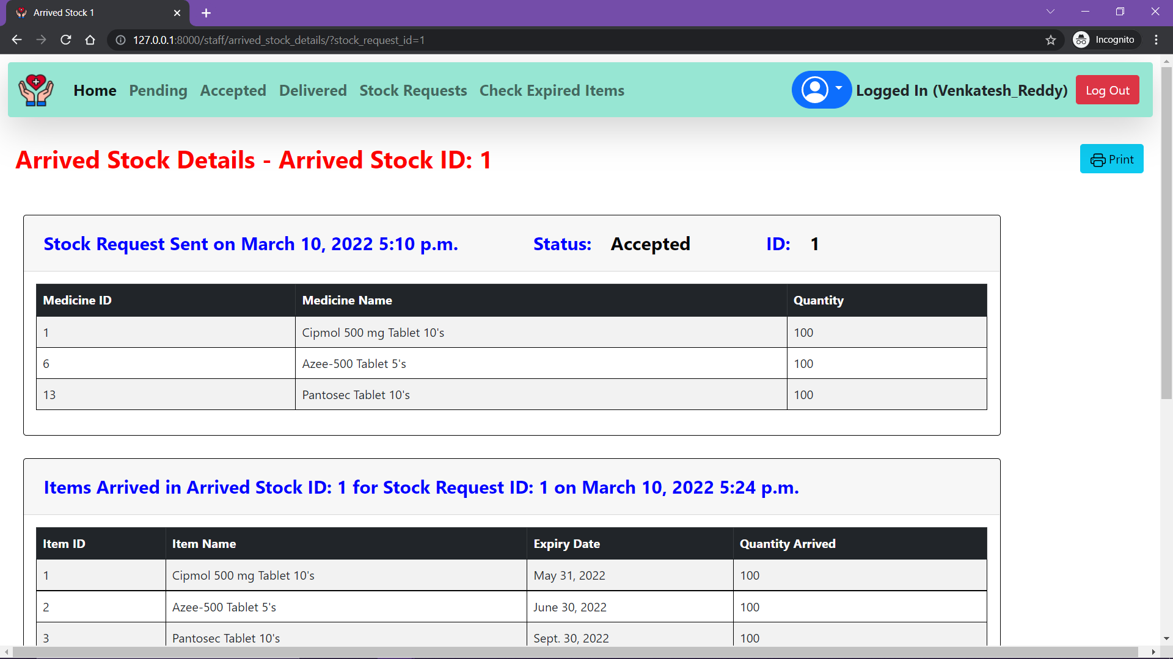
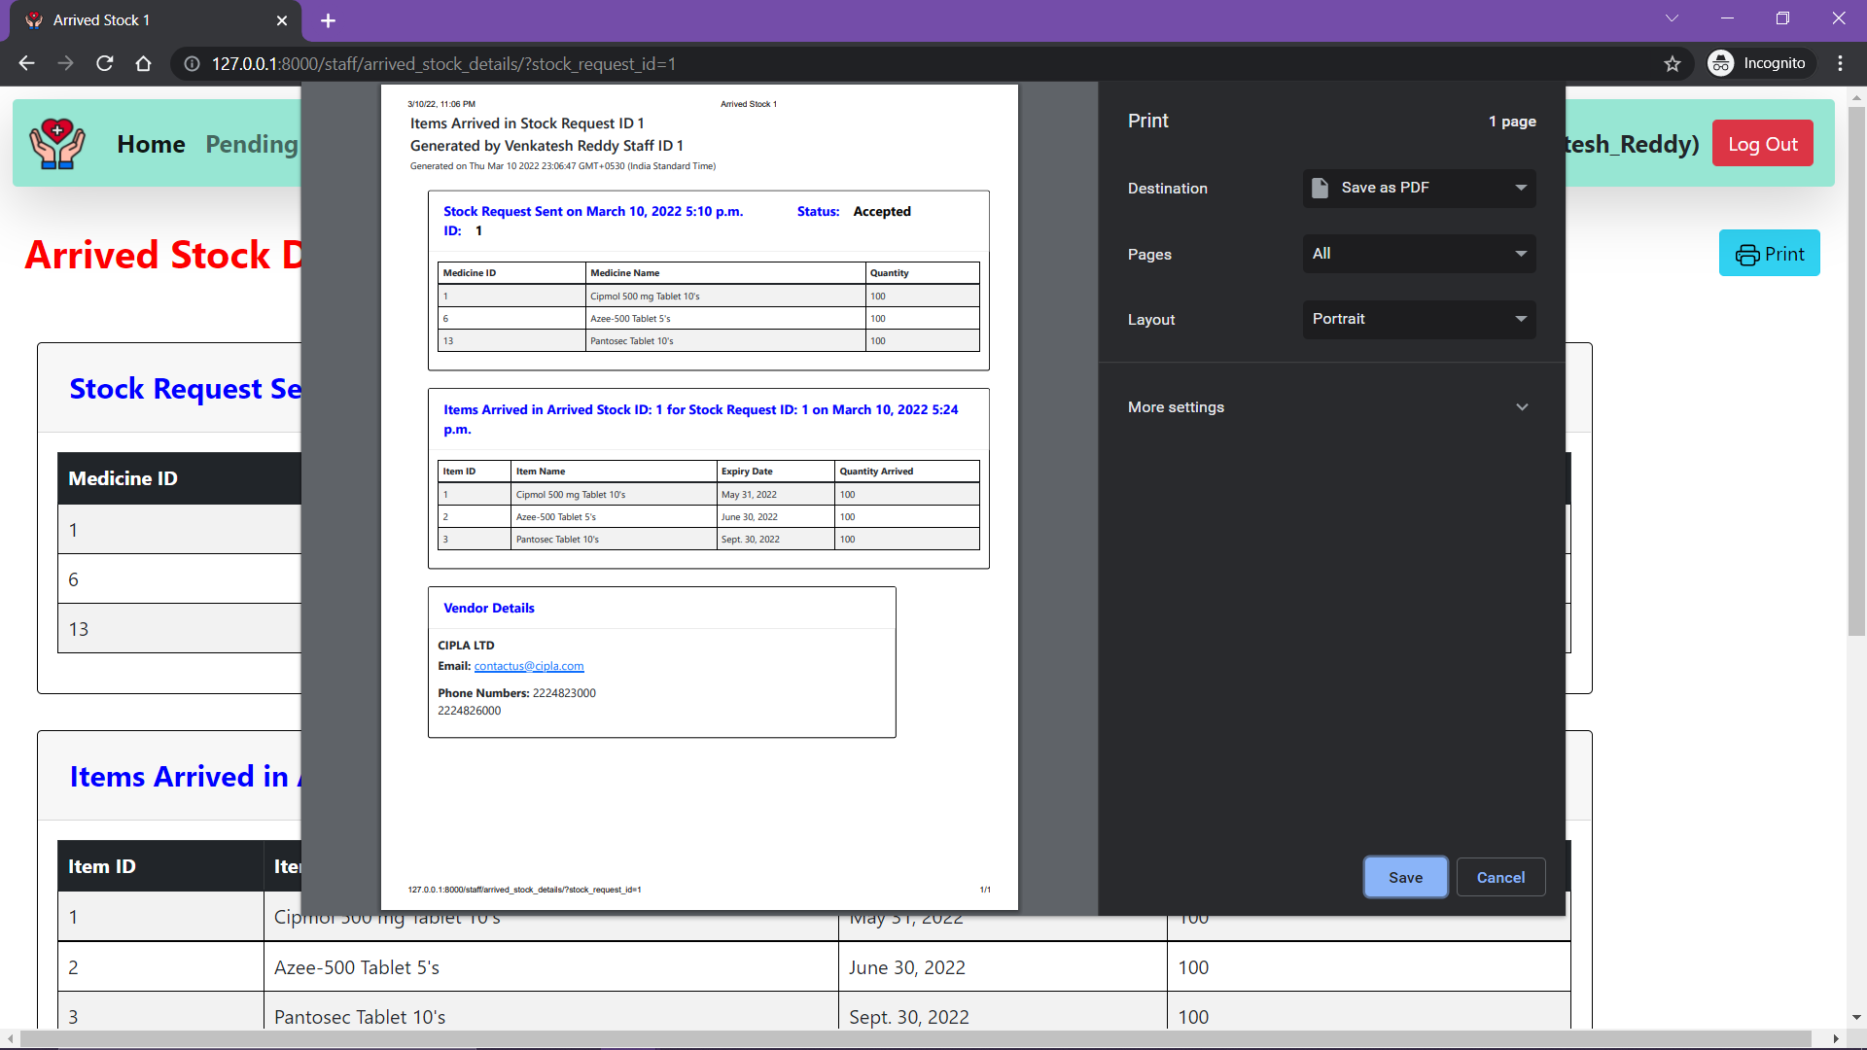
FEATURE 20 : VIEW DETAILS OF ARRIVED STOCK AND PRINT
Click Here
Click Here

Slide 37
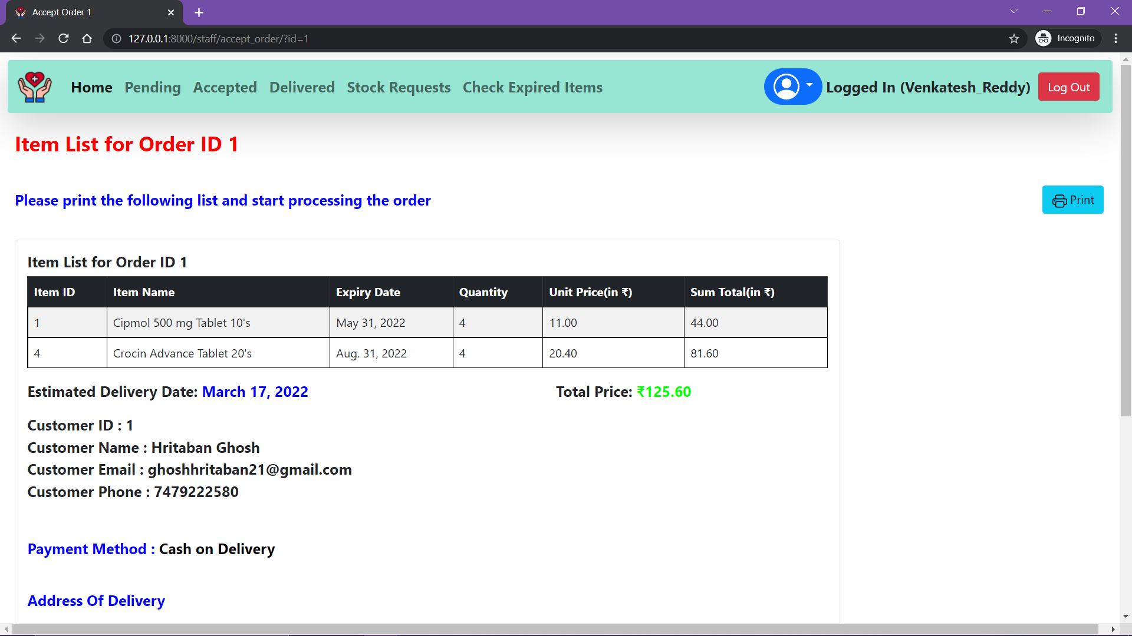
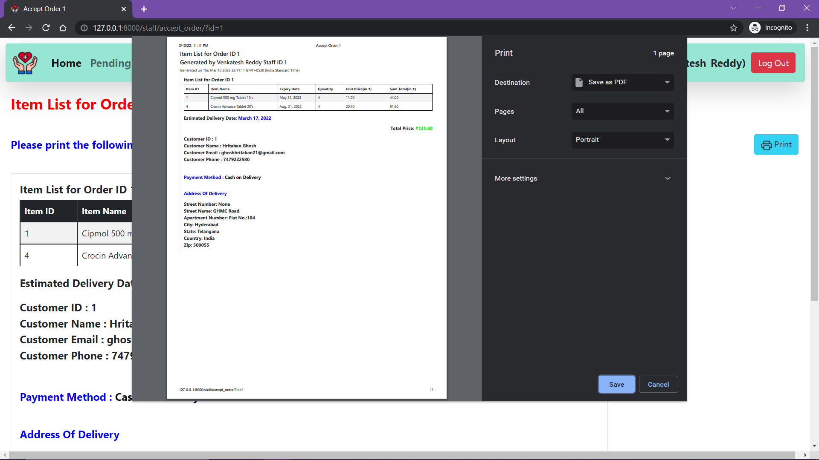
FEATURE 21 : TRY TO ACCEPT AN ORDER AND SUCCEED
Click Here

Slide 38
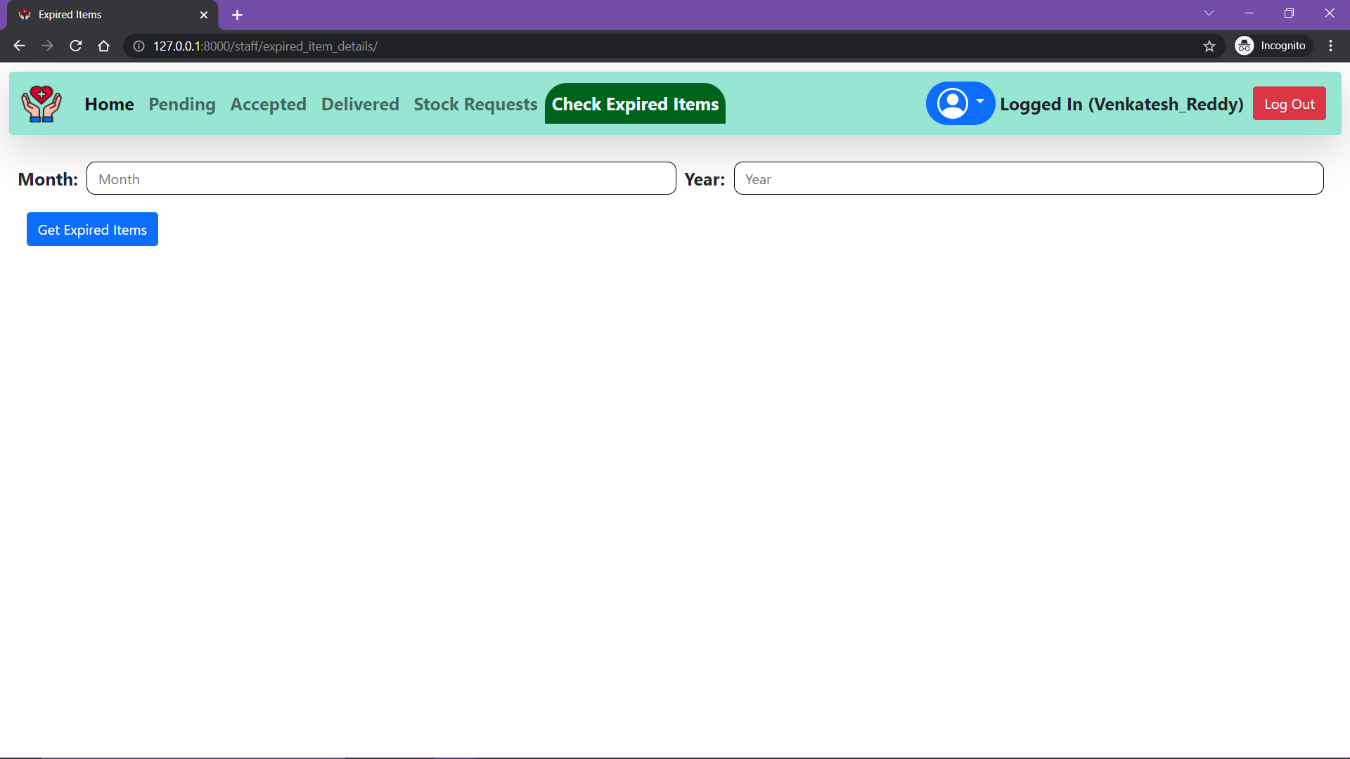
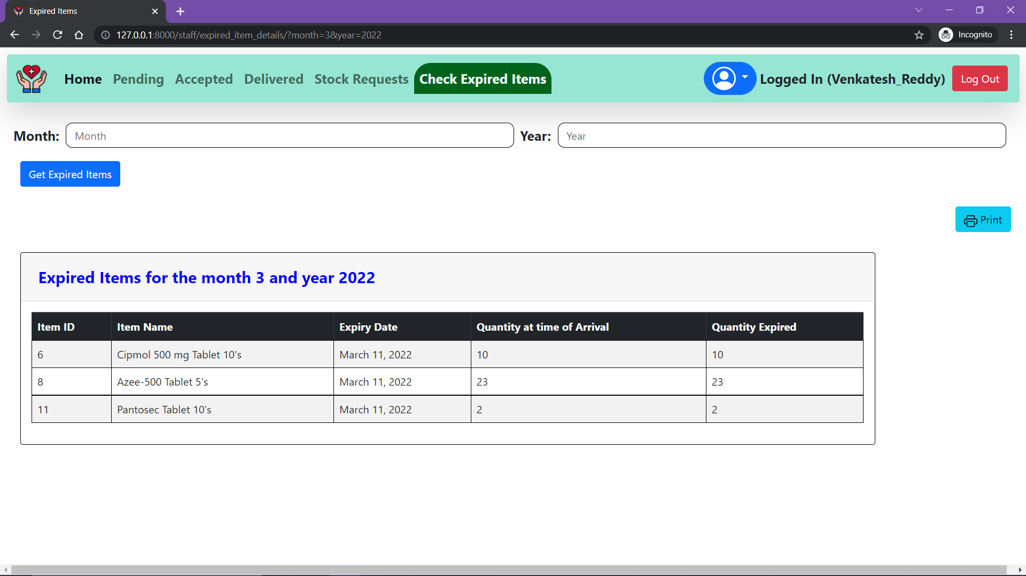
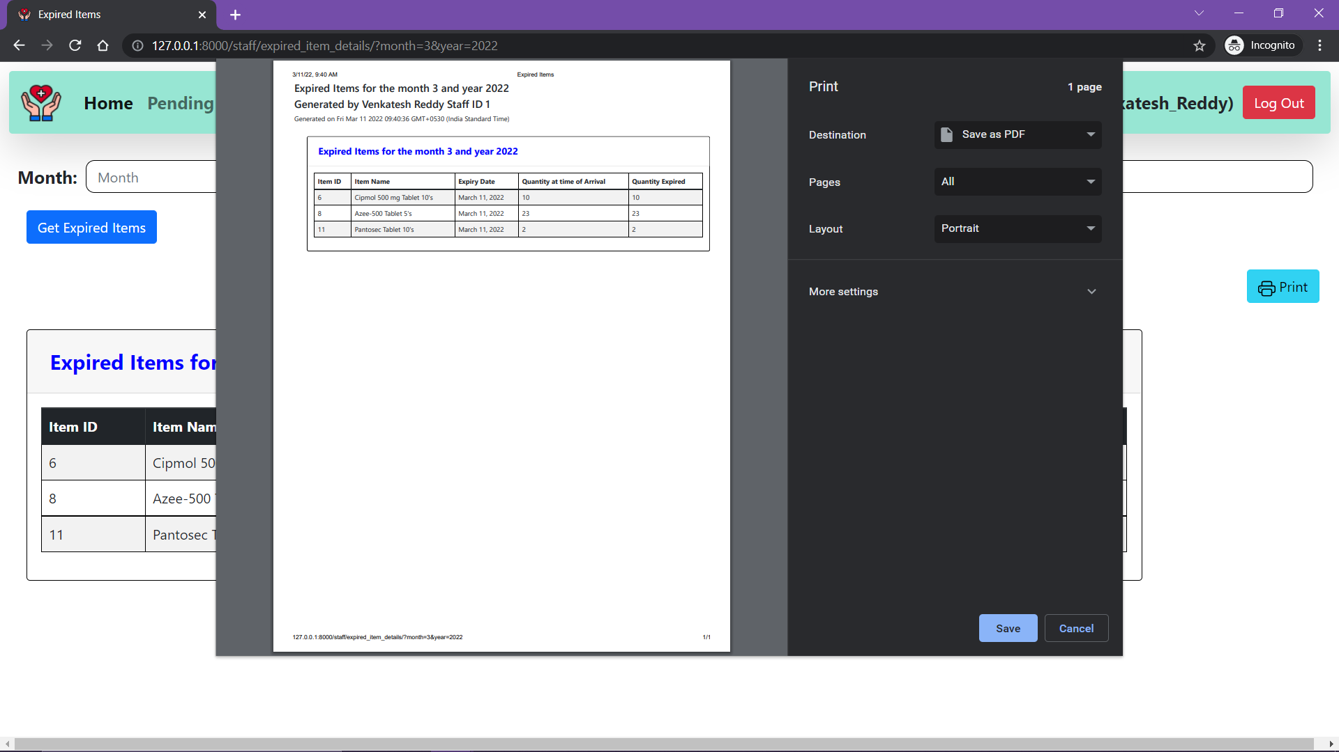
FEATURE 22 : CHECK EXPIRED ITEMS
Note the query parameters
Enter the month and year for which you want the expired items

Slide 39
VENDOR VIEW
In the following slides all the features accessible to a staff member of the pharmacy are explained in detail.
Note: For an company to be qualified as a vendor the admin needs to register them first.

Slide 40


FEATURE 23: LOG IN USING VENDOR CREDENTIALS AND GET VENDOR VIEW

Slide 41

FEATURE 24: ACCEPT A STOCK REQUEST

Slide 42

FEATURE 25: VIEW STAFF DETAILS

Slide 43


FEATURE 26: REJECT A STOCK REQUEST

Slide 44
ADMIN VIEW
In the following slides all the features accessible to the admin of the database are explained in detail.

Slide 45


FEATURE 29 : LOG IN USING ADMIN CREDENTIALS AND GET ADMIN VIEW

Slide 46




FEATURE 30 : ADD VENDOR
Click Here
Add User
Fill in the details and save
Vendor added successfully

Slide 47



FEATURE 31 : ADD MEDICINE
Fill in the details and save
Click Here
Medicine added successfully

Slide 48




FEATURE 32 : ADD STAFF MEMBER
Click Here
Add User
Fill in the details and save
Staff added successfully

Slide 49
50
FUTURE SCOPE
40
30
Add a delivery person view
Add more hierarchy to the management
Add statistical tools to generate reports
Improve customer experience
20
10
0
Item 1
Item 2
Item 3
Item 4
Item 5

Slide 50
THANK YOU!
Hritaban Ghosh 19CS30053

